Slide 1
Chapter 9 Build a Community for Learning
Promote Mutual Care, Support,
and Celebration

Slide 2
The Impact of Caring Teachers
Can you remember teachers who taught you by example about caring and helped students create that sense of caring with one another?

Slide 3
Seeing Community in 2 Classrooms
6th grade social studies
Students reading with a student with a severe disability
Teacher includes this student in dialogue and questions
Students help Duane get around the classroom into groups
3rd grade elementary
Cooperative learning
Classroom meetings
Heterogeneous grouping
Welcoming a student with a cognitive disability
Writing at his own level of ability – amazing growth

Slide 4
Sights to See
Emotional and Academic Learning Together
Emotional Intelligence
www.edutopia.org/emotional-intelligence-overview
Educating Hearts
www.edutopia.org/anchorage-social-emotional-learning-video

Slide 5
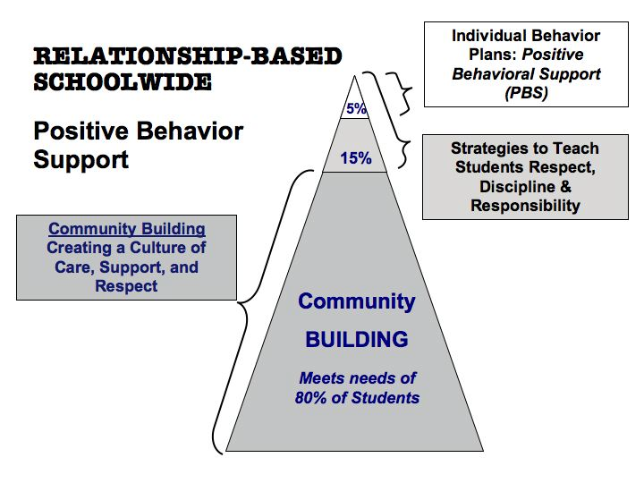

Slide 6
Community Implications for Teaching
Belonging –seek to help all children by explicitly dealing with differences and conflicts.
Inclusion – membership is open and teachers make intentional efforts to accommodate and value diversity.
Support and Care – teachers provide assistance, support, mentoring, and care to help students cope with their problems.
Contributions and Responsibility of All Members – All have both the opportunity and responsibility to contribute to the good of the whole.
Democratic Problem-Solving – Conflict, problems or decisions are addressed through dialogue and consensus.

Slide 7
What does community look like?
Toward Community…
Students helping students
Students talk about differences
Students have strategies to address conflict
Classroom meetings
Away from Community…
Students are ridiculed and/or isolated
Teachers yell at students
Conflicts erupt in fights and arguments
Students with learning differences are sent to special programs

Slide 8
Bumps in the Road
Social Isolation Leads To Segregation
Cheryl, a cute girl, had no friend
The paraprofessional helped isolate her
She had separate academic lessons off to the side of the class
The principal wasn’t interested in helping
Her mother sent her to a segregated school because she was lonely

Slide 9
Bumps in the Road
Social Isolation Leads To Segregation
Nathan had a paraprofessional
He was given a separate seat facing away from the class because the teacher considered him disruptive
A group of students was willing to help Nathan as a circle of support; they were excited
The teacher thought it was too much trouble
Nathan left the school because he was depressed every day

Slide 10
Community and our Five Needs
LOVE
FUN
POWER
HUMAN
NEEDS
FREEDOM
SURVIVAL
Glasser, 1992

Slide 11
Maslow’s Hierarchy of Needs
Self Actualization
Self-esteem
Belonging/Love/Affiliation
Safety/Security Needs
Physiological Needs

Slide 12
Connections
Academic Learning, Emotions, and Community
Emotional intelligence is as important to adult success as cognitive development
The emotions are the gateway to cognitive development
When students feel safe and engaged academic learning increases

Slide 13
Beyond Behavior Management To Community
What do we really want of students?
To comply or to be proactively responsible?
Building community teaches responsibility and focuses on . . .
Internal locus of control
Rather than external locus of control
Resulting in more responsible, self-determined children and youth

Slide 14
Resiliency in Children
Characteristics
Social competence
Problem solving skills
Autonomy
Sense of future and purpose
Protective Factors
Expectation of and opportunities for success
Positive relationships with adults and peers
Participation and meaningful contribution
Acceptance and fulfillment of responsibilities
Decision making skills and power
Safe and predictable environment
Clear norms regarding tobacco, alcohol, and drugs

Slide 15
The Process of Building Community
Several stages in any group:
Pseudo-community
Chaos
Emptiness
Community
Maintaining community

Slide 16
The Foundations of Community
Democratic and Collaborative Decision Making
Supports for Teachers and Students
Parent and Community Connections

Slide 17
Key School-wide Practices
that Promote Community
Creating a Child- and Family-Centered Vision
Collaborative Learning Circles
School-wide, Multi-class Themes for Learning
Celebrations for All

Slide 18
Building Classroom Community
Routines and Structures
Getting Started
What do we want to learn?
Promoting student ownership through democratic exercise of power
Classroom rules that promote community
Getting to know the classroom community
Class meetings

Slide 19
Building Classroom Community
Sustaining Structures
Daily routines
Class meetings
Sharing: celebrations, joys, challenges, grief, and pain
Communicating respectfully
Making choices
Multilevel cooperative learning
Sharing work

Slide 20
Student Roles
in the Learning Community
Student Classroom Leadership
Helping Others as Experts
Buddies, Tutors, and Peer Mentors
Circles of support

Slide 21
A Circle of Friends
Makes a Difference
No separate school for “our Brandon”
A circle to help Brandon
Students selected areas in which they also needed improvement
From helping to a ‘kids club’ that benefitted all
Circle kept going without adult assistance

Slide 22
CHAMPIONS OF INCLUSION CREATIVELY adapt and utilize appropriate strategies and materials to help students with disabilities learn and succeed.
Champions of inclusion are:
The classmates who help Frankie (who has autism) participate in the skit of a scene from the American Revolutionary War
The special education teacher who writes a simplified version of Romeo and Juliet for Juan (who has cognitive delays)
the basketball coach who arranges tasks for Carmen (who has Down Syndrome) so that she can serve as the assistant manager for the team
William (who has Asbergers) who shows his class a more efficient way to solve a math problem

Slide 23
Celebrating Difference
Our goal is to build an inclusive community
in which students…
NOTICE
VALUE
CELEBRATE
…differences!

Slide 24
Intentionally Promoting Inclusion and Relationships
Frames of Relationships
Ghost/guest
Inclusion kid
Kid who needs help
Just another kid
One of my friends
Best friend forever

Slide 25
Celebrating Difference
Intentionally Promote Inclusion and Relationships
Daily support in developing positive, caring relationships
Ability Differences Up Front
We all have different abilities
Children’s Literature
Read aloud and discuss books that address differences
Thematic Units
Intentionally study human differences

Slide 26
Back Pack
Social and Emotional Support
Responsive Classroom
www.responsiveclassroom.org/
Tribes www.tribes.com/
Center for Social and Emotional Learning csee.net/climate/

