Slide 1
Chapter 8
Make Environmental Accommodations and Use Assistive Technology
Tools That Extend Human Capacity and Promote Learning

Slide 2
Assistive Technology
Consider this quote from your text:
“From one perspective, we are all disabled, and technology helps us do things we could never accomplish otherwise.”
How does this perspective affect your thoughts about assistive technology in the classroom?

Slide 3
Including Cedric
with Help from Assistive Technology
Cognitive disability, no verbal language, difficulty walking, interesting guy
Yes-no communication device
Recorded message to the group about a family outing
All the students are learning about assistive technology

Slide 4
Supporting Shannon
with Assistive Technology
Blind, planning to be a lawyer
Students read to her
Books on tape, CD, and MP3 files
Writes using a word processor and hears writing via DragonSpeak
Uses dictation software
History textbook scanned so it can be read aloud via software

Slide 5
Sights to See
Including Stacey and Shawn with Assistive Technology
Stacey, as 6th grader, has a significant hearing loss.
www.nationaltechcenter.org/index.php/2007/03/04/stacey/
Sean, a junior in high school, is blind.
www.nationaltechcenter.org/index.php/2007/03/05/sean/
From the I Can Soar video of the National Center for Technology Innovation.

Slide 6
Positive Outcomes
from Assistive Technology
Increased self-motivation
Increased independence
Greater participation
More accountability
Expanded learning and life experiences
New opportunities for interactions and communication
Changed vision of the child’s potential

Slide 7
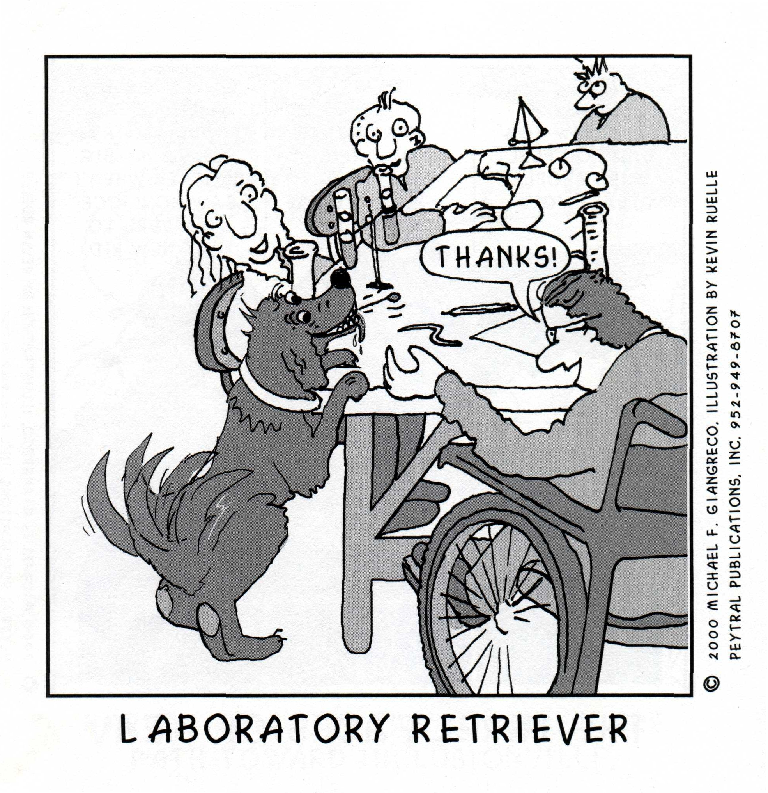
Assistive Technology: What is it?
The use of any tool or device that can help a person perform a task or learn.

Slide 8
Categories of Assistive Technology
Low-tech
  Rubber pads to hold materials on desks
  Large pencils
  Communication boards with pictures or words
High-tech
  Computers
  Electronic alternative communication devices
  Electronic wheelchairs with joystick or “puff-and-sip”

Slide 9
Journey Into the Classroom
Assistive Technology in the Classroom
Manuel
Uses AAC device to communicate at recess
Uses power wheelchair and Light Talker which allows him to talk via synthesized speech
Children help Manuel and he says “Let’s play ball”
One of the other students hits the ball for him and he ‘runs’ in his wheelchair to first base

Slide 10
Journey Into the Classroom
Assistive Technology in the Classroom
Latisha
Minimally verbal student; teachers do not know if she understands
Beanbag chair on the floor
Grab rail near the teacher
AAC devices and interactive story tools such as puppets and velcro boards
AAC device where child could communicate about story
Other students liked these tools as well

Slide 11
Journey Into the Classroom
Assistive Technology in the Classroom
9th grade algebra class
Authentic projects using math skills allowing differing ability levels
Interdisciplinary projects with art and social studies teachers
Measuring tape with synthesized speech
Interactive math and graphics software that facilitates computations

Slide 12
Assistive Technology:
Required by IDEA
Development
  Government
  For-profit
  National organizations
Availability
  State networks
  Regional resource centers
  For-profit
Professionals
  Engineers
  Occupational therapists
  Physical therapists
  Speech therapists
  Special education teachers

Slide 13
ASSISTIVE TECHNOLOGY
What will it look like?
  Access to the School
  Ramps
  Electronic Doors
  Playgrounds accessibility
  Elevators
  Hall rails
  Bathroom access

Slide 14
ASSISTIVE TECHNOLOGY
What will it look like?
Classroom
  Adequate floor space
  Clustered tables
  Lowered shelf height
  Couch
  Chair with arms
  Various writing utensils
  Adjustable desks and tables

Slide 15
Assistive Technology:
How will we use it?
Aids to understand or remember
Manipulating or controlling the environment
Seating and positioning
  Posture control
  Pressure control
Enhance communication

Slide 16
Augmentative and Alternative Communication (ACC)
Physical Movement and Gestures
Facilitated Communication
Communication Boards
  Pictures/words
  Simple Electronic
    Verascan
    BIGmack
  Sophisticated Electronic
    VOCA
    Dynavox
ACC allows students to interact with classmates socially, and as part of the learning community

Slide 17
Adapted Computer Access
Computer Input
  Standard keyboard
  Adapted keyboards
  Alternative keyboards
  Communication devices
  Voice to text software
Computer Output
  Text-to-speech
  Magnified screen images
  Tactile output
Computer Software
  Access and express information
  Produce evidence of learning

Slide 18
Assistive Technology For Individuals with Visual Impairments
  Magnification devices
  Closed circuit television
  Recorded materials
  Braillers
  Reading systems
  Adapted tools and measuring devices

Slide 19
Assistive Technology For Individuals with Hearing Impairments
  Hearing aids
  Telephone access: TDD
  Speech interpretation aids
  Alerting devices
  Classroom amplification systems
  FM units

Slide 20
Assistive Technology For Mobility
Persons who are blind:
Orientation and mobility specialists
Sighted guides
Canes
Electronic travel aids
Wheelchairs:
Manual
Powered
Vehicle accommodation

Slide 21
Bumps in the Road
Lack of Access
  Too often assistive technology is not available in some schools
  What to do?
  Work to incorporate assistive technology into the over technology plan for the school
  Reach out and locate the local or regional assistive technology center to obtain assistance for your students

Slide 22
Back Pack
Assistive Technology Goldmines
Closing the Gap
www.closingthegap.com/index.lasso
National Center for Technology Innovation (NCTI)
www.nationaltechcenter.org/

