Slide 1
Chapter 7 Develop an Inclusive School and Classroom
Use Space and Physical Resources to Support All Students

Slide 2
A High School for Learning
“We Are a Learning Community” - an engaging theme
Commons area for events and social interaction
Room connections for interdisciplinary teaching
No special education rooms -- all push in services
Learning resource center for all students

Slide 3
Sights to See Including Nick
YouTube video regarding Nick, an elementary child with Down Syndrome, being included in general education classes.
www.youtube.com/watch?v=ji3R30PT1PQ

Slide 4
The School Feels Like Home
Welcoming secretary and staff
Engaging principal
Student projects displayed
Diverse children interacting
Push in services of specialists and paraprofessionals

Slide 5
Universal Design A Few Examples
Ramps and automatic doors are helpful to all
Talking software, can increase productivity for all
Recorded books are useful for all people

Slide 6
Principles of Universal Design
Equitable Use
Flexibility in Use
Simple and Intuitive Use
Perceptible Information
Tolerance for Error
Low Physical Effort
Size and Space for Approach
“…products and environments to be usable by all people to the greatest extent possible.” Steinfeld, 1994

Slide 7
Guidelines for . . . Healthy Learning Environments
Stimulate healthy awareness of ourselves and others
Enhance connections with nature, culture, and people
Do no physical harm
Are beautiful and inviting
Provide meaningful, varying stimuli
Encourage times of relaxation and privacy
Balance constancy and flexibility
Use resources flexibly for multiple purposes

Slide 8
School-wide Strategies Creating a Welcoming Place to Be
Provision of a commons area
Creating a school within a school
A parent and community center
A media center/library
Space and inclusive classrooms
Space for specialists

Slide 9
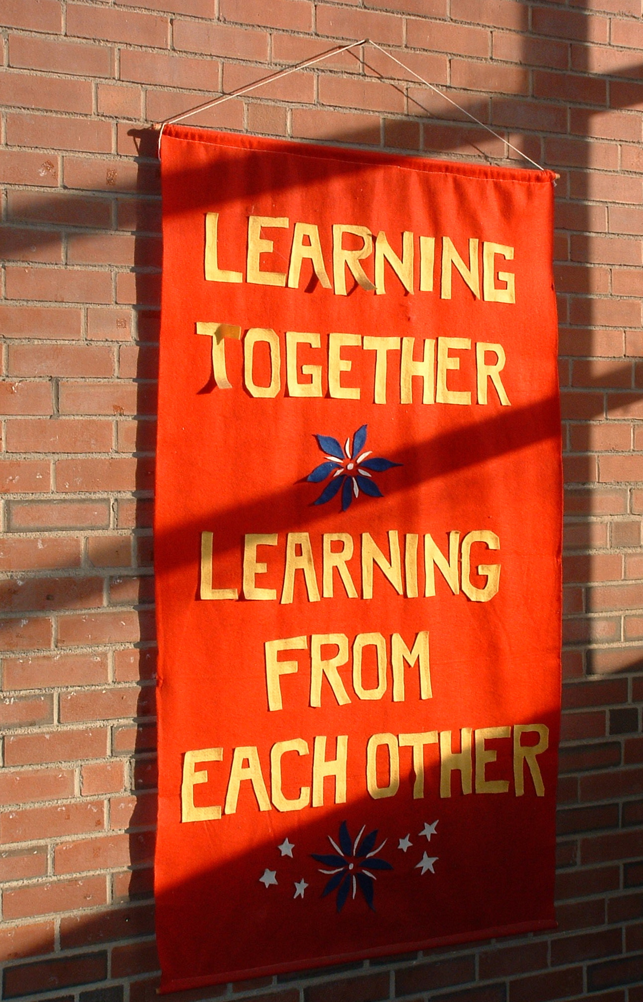
SCHOOL MISSION STATEMENTS DISPLAYED CAN SEND AN IMPORTANT MESSAGE.

Slide 10
Lunch and recess Opportunity for disaster or community
Rejection, isolation, racial tension all can occur in this more unstructured time
Need: positive opportunities for interaction
Provide interesting activities for free time with the help of teachers, aides, and community volunteers
Establish teacher/student discussion lunch groups
Assign older students jobs and responsibilities

Slide 11
School-wide Strategies
Use specialized materials for ALL students
Inclusive transportation - beyond the ‘special bus’
Inclusive playgrounds -- designing for access and engagement for all students

Slide 12
Bumps in the Road
Organizing For Control Rather Than Learning
Desks in rows
Isolating students seen as problematic - desks facing wall, etc.
Places for ‘bad’ students
Such teachers believe welcoming environments will not work with ‘their’ students
No modeling, teaching or learning is occurring
The most suspensions in the school
What to do?
Do you do this? If so, are you willing to question your assumptions and work towards a different approach?
Get to know these teachers and help suggest and model other strategies. Offer help. They are overwhelmed!!

Slide 13
The Classroom Designing an Inclusive Learning Community
Establish a comfortable home-like atmosphere
Allow for different learning styles
Design multiple ways to access information
Insure physical and sensory access
Use space in the school to support inclusive teaching

Slide 14
TRADITIONAL CLASS ARRANGEMENT
Desks in rows.
Little movement allowed.
Bathroom in groups.
Physical separation of child special needs - back or side of room.
What negative impacts are there?
Constant work to ‘keep kids in their desk’
Problems with kids that need to move.
Lack of learning responsibility.
Isolation of children with special needs.
And more. . .

Slide 15
Classroom Design and Arrangement
TRADITIONAL
Desks in rows.
Little movement allowed.
Bathroom in groups.
Physical separation of child
Separate space, back of group
TOWARD UNIVERSAL DESIGN
Carpet areas for group time
Bathroom passes as needed.
Multiple places to read & work -- under desk, corner, table, hall.
Varied, integrated grouping and pairing of children
Space shared rather than owned.

Slide 16
What will the room look like?
Teacher’s desk to the side
Displays of student work and interesting materials
Students seated in groups
Places for students to work alone
Learning Centers
Some students working in the hallways
Many opportunities for student movement
Food and drink easily available

Slide 17
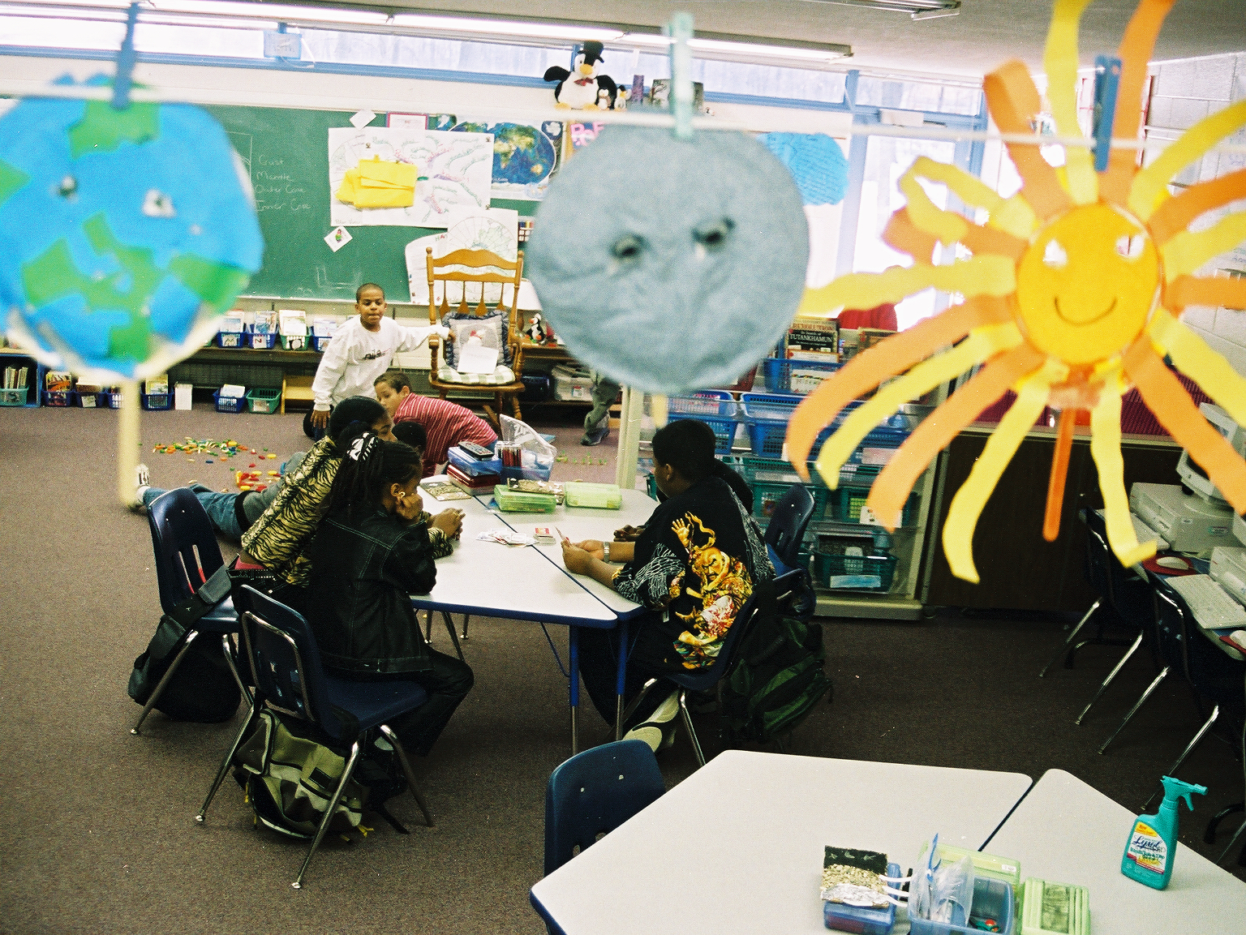
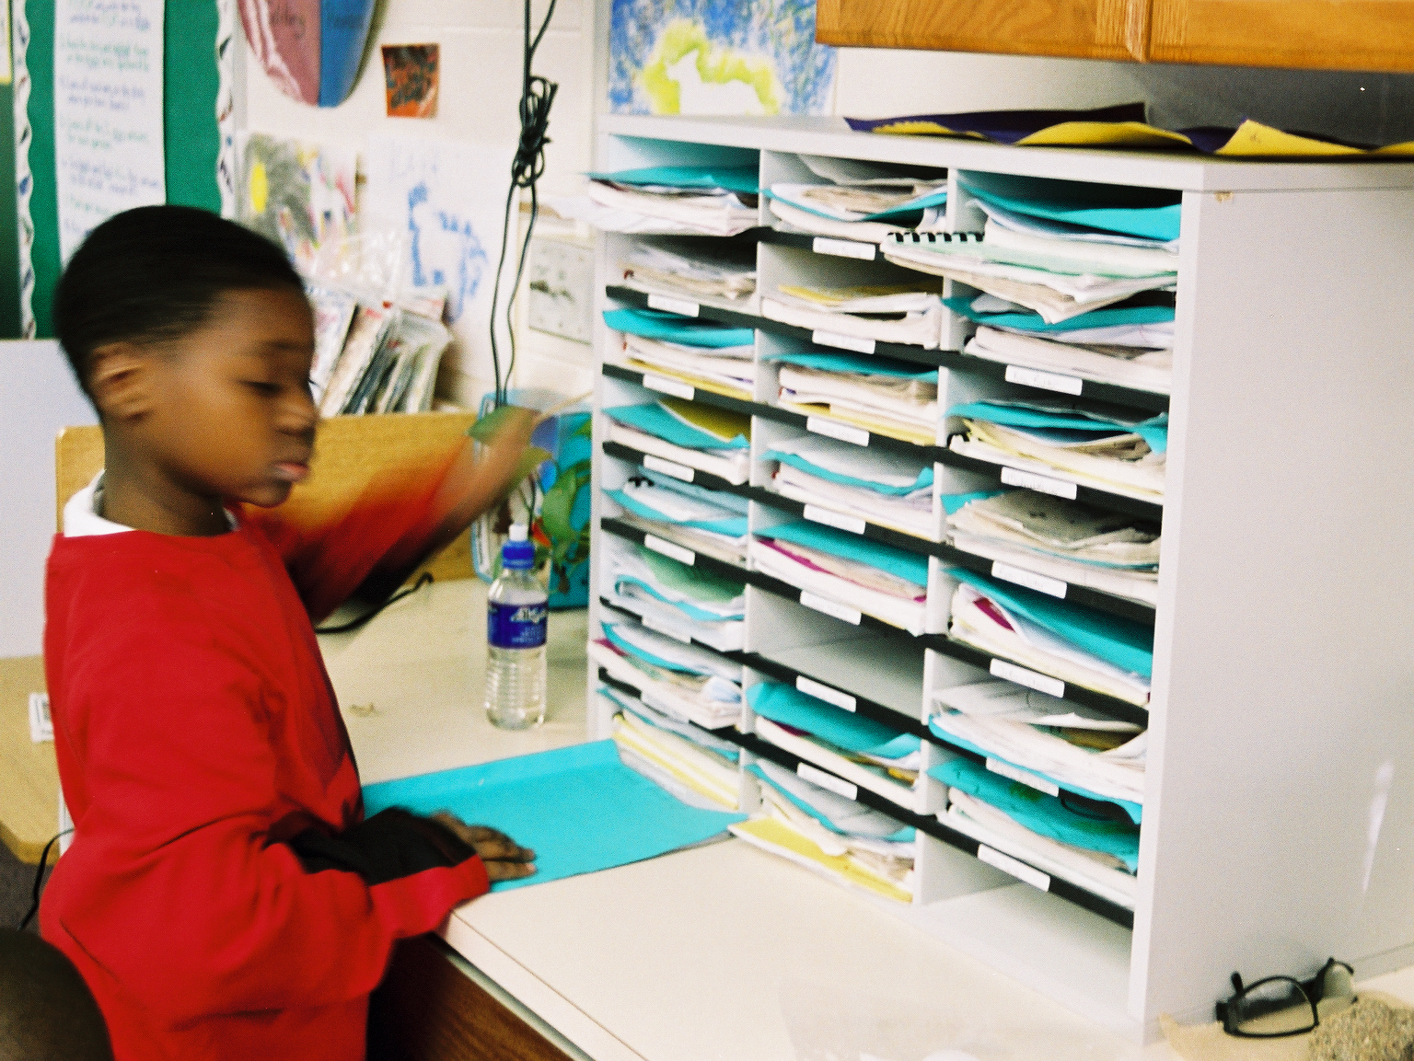
Student work throughout the room.
Student cubbies to organize materials.

Slide 18
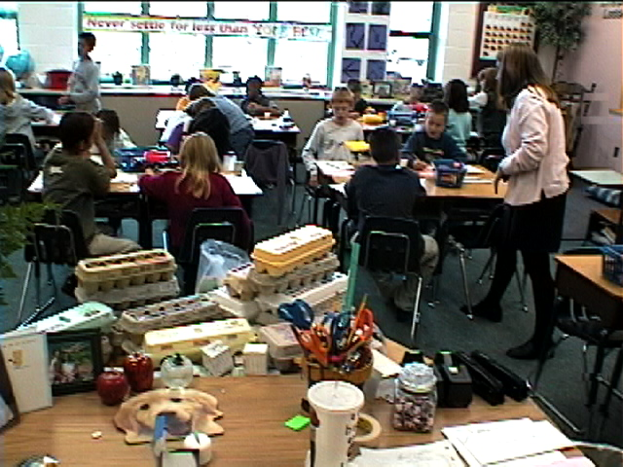
Building A Model Of Our Town In An Inclusive 3rd Grade

Slide 19
Multiple Strategies
Compile materials to address multiple intelligences and learning styles
Analyze the classroom from the perspective of individuals with different types of disabilities.
Provide a multitude of books at multiple levels
Utilize computers as ongoing tools within the classroom as well as communication tools with parents.

Slide 20
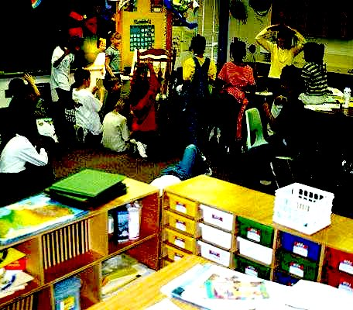
Creating An Interesting Room With A Range Of Centers For Different Types Of Work
Group area
Centers for teaching lesson & extra projects.
Cubby holes
Comfortable space

Slide 21
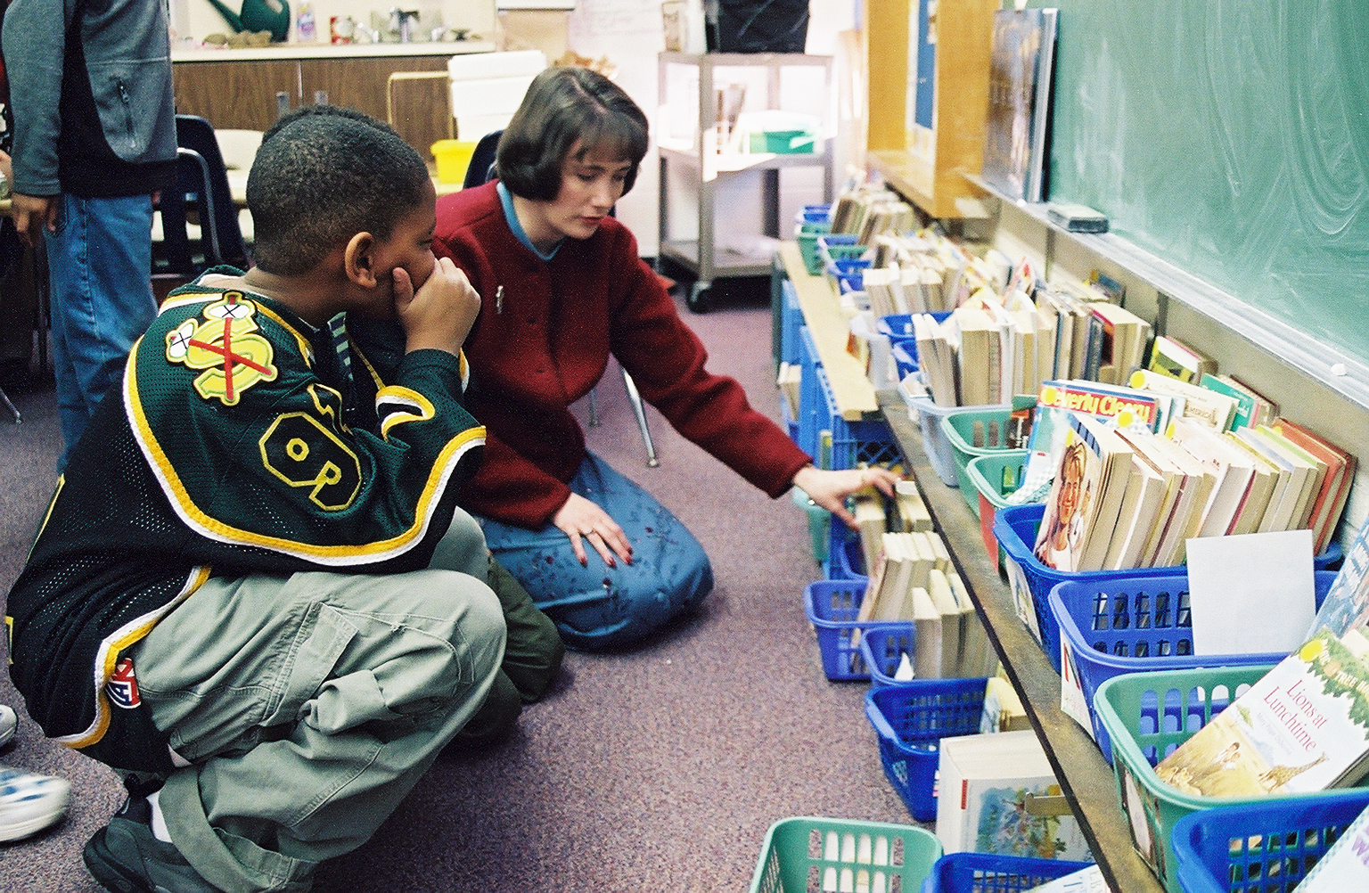
Classroom Libraries With Books Of Multiple Genres And Ability Levels

Slide 22
LEARNING STYLES
Elements
Stimuli
Environmental
Sound
Light
Temperature
Design
Emotional
Motivation
Persistence
Responsibility
Structure
Sociological
Responses to being with people while learning..
Physical
Perceptual
Intake
Time
Mobility
Psychological
Analytic-global
Locus of control
Reflective-impulsive
Adapted from Dunn & Dunn, 1987; Dunn, 1996

Slide 23
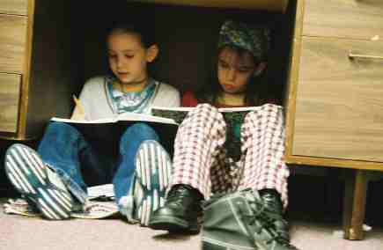
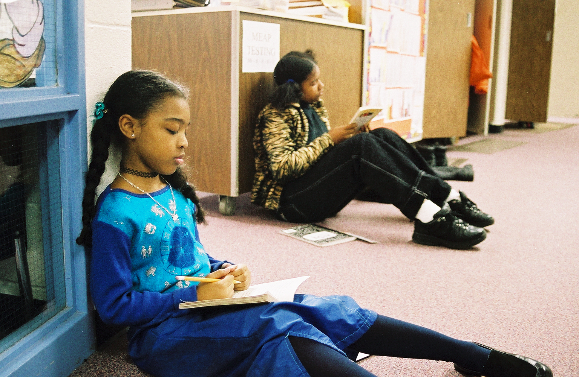
CREATING SPACES FOR MORE PRIVACY AND QUIET WORK

Slide 24
Journey into the Classroom
Creating Places to be Alone
Classroom design was a problem when Mia took over the class
Cleared out stacks of papers and put up bright paper where student work could be placed
Grouped all desks in clusters of 4-5
Made spaces for privacy by turning cabinets to right angles
Found a study carol to be used as a ‘safe place’ when students wanted it
Put a table and chair in sight out in the hallway

Slide 25
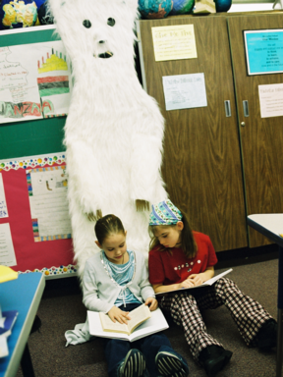
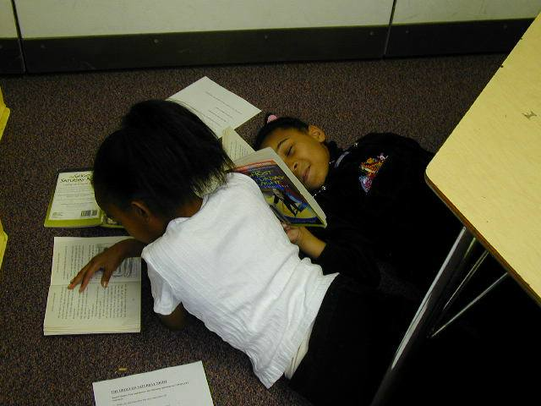
Places To Stand, Sit, Lie While Learning.

Slide 26
Guidelines for Creating an Enriched Learning Environment
Provide classroom with broad-based reference library
Make the environment body-compatible
Eliminate clutter and distractions
Change bulletin boards, displays etc. frequently
Immerse students in reality
After first-hand resources have been exhausted use second-hand experience
Supplement first-hand experiences with books, videos & print materials
Spend money on real materials for students

Slide 27
Connect with the Local Community!
Community learning opportunities:
Interesting local people
Associations and groups
Landmarks
Businesses
Community institutions
Open fields, streams, and other natural resources

