Slide 1
Chapter 4
Planning Individualized Differentiation
Interventions For
Students with Special Needs

Slide 2
Peaking at Collaborative Consultation
Getting Help and Support
Organizing structures where teachers get help for challenging students
Student has medical issues which trouble the teacher
She meets with the support team to talk
The team meets every week with different teachers
They listen and all talk about needs and strategies
They are proactive and positive - no complaining about students or parents!

Slide 3
Individual Differentiation and Interventions
For Students with Learning Challenges
Understand student needs and explore strategies to help. 6 steps:
Develop a profile of the strengths and needs of the student
Gather information that helps us understand the needs of the student through student-centered observations, student work, and input from parents and others
Articulate a theory regarding the student’s challenges and needs
Identify strategies that have potential to assist the student
Use these strategies while collecting information and data to see how well they are working
Review the information and make needed changes.

Slide 4
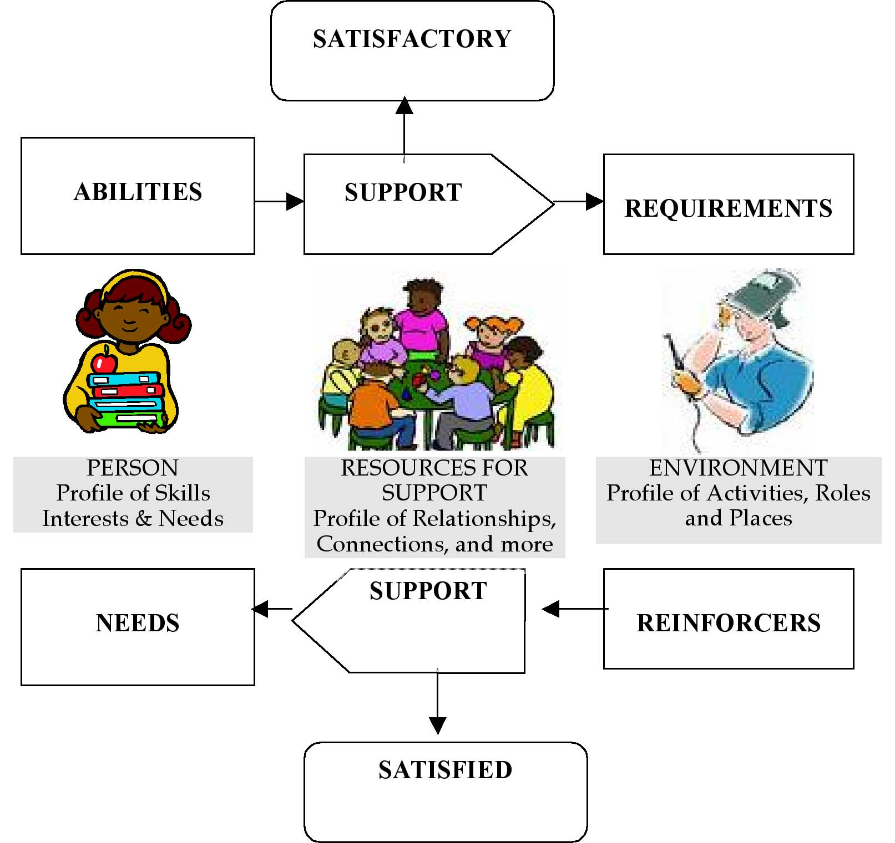
Ecological Framework to
Understand Student Needs

Slide 5
Steps for Individualized Differentiation
Understand student profile and needs—abilities, interests, fears, resources, supports.
Analyze our classroom and lesson(s).
Determine problems in the student participating and learning due to mismatches between the student and the environment and lesson requirements.
Develop solutions — manageable strategies to help the student participate meaningfully, learning at his or her own level.

Slide 6
Differentiating for an Individual Student
Learning Activity | Problem | Solution
High school history class is to read about the U.S. Constitution and complete a worksheet of questions and answers for comprehension. | Student reads at third-grade level and can’t read the text. She also has difficulty writing answers and understanding complex material. | Student is given simplified material about the Constitution at her reading level. A peer buddy summarizes key points and explains them. The student works with a group illustrating some key points.

Slide 7
Sights to See
A Student with Autism Included
www.youtube.com/watch?v=qwBvfyVpWUc

Slide 8
Individual Student Profile
A Tool for Thinking About a Student
Dreams for the student
Needs for support and assistance
Strengths of the student
Successes
Like and dislikes
Greatest challenges
Reading
Writing
Math
Work habits
Communication
Sopial
Behavior
Motor
Other

Slide 9
Identifying Student Strengths and Needs
Strengths
  What are the strengths of this student?
  How can we build on this student’s strengths to help him deal with problems?
Needs
  Tied to the goals the student wants to accomplish…need for what?
  Must be separated from adult wishes for a student to be or act in a certain way.

Slide 10
Class Profile
A Tool for Thinking About Our Class
Meets Student Needs
Approach to curriculum
Materials
Advance planning
Content
Physical environment and seating
Student participation
Teacher presentation / facilitation
Tests, assignments, and evaluation
Classroom climate and management
Home-school communication

Slide 11
Tools for Individualized Differentiation
& Interventions (Tiers II & III)
Collaborative Consultation
Making Action Plans (MAPS)
Curriculum Matrix
Daily Schedule (with supports and adaptations)

Slide 12
MAPS
A Student Centered Planning Process
What is your history and experience?
What are your dreams?
What are your nightmares?
Who are you?
What are your strengths?
What are your needs? (to reach towards dreams)
What is the action plan?

Slide 13
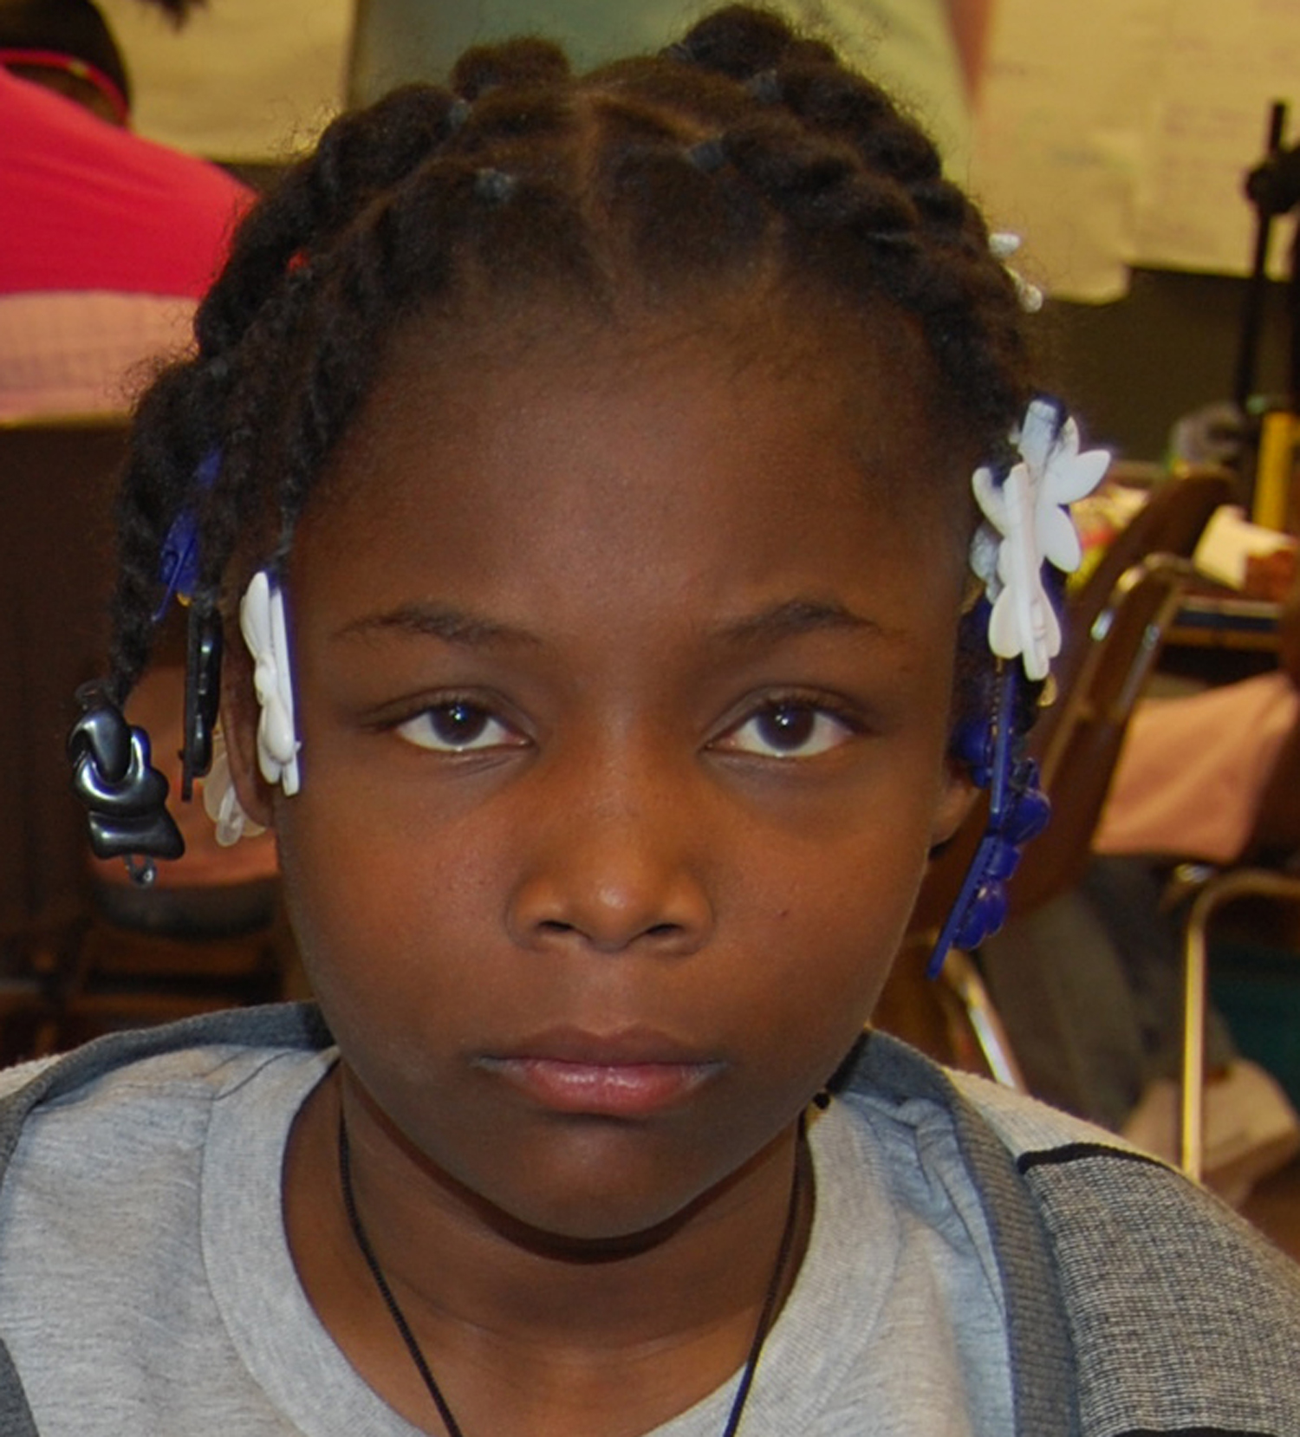
Individualized Differentiation for a Fifth Grader
Arrival
Check in with Michelle and share backpack contents.
ｷBuddy reminds him to sign up for lunch
Science
Gathers group materials
Draws/ labels in journal.
Books on tape.
Choice time.
Works with buddies: reading out loud, listening center, math activities
Social studies
Pair for research and write 3 facts
Group act out historical events
Draw pictures for notes
Reading / Writing workshop
Scaffolds writing with lines for each word.
reads books read first with teacher
Math
Buddy explains directions.
Manipulatives for concepts
Simple goals
Art
Buddy explains directions one step at time
Sit with buddy to model after
Physical education
Team games
Buddy Pair: build friends and directions
Relationships
ｷCircle of support
ｷPeer buddies
ｷDiscuss feelings and how to handle
Support Staff
In room 40 minutes a day
Work with his math group

Slide 14
Accessing Formal Services
Developing More Intense Individualized Classroom
Interventions for Students (Tier III)
Dominant language learners
Gifted and talented
Section 504
Early intervention services
Vocational rehabilitation and community mental health that collaborate with educators
Special education

Slide 15
Dominant Language Learners
Assessment of difficulties with the dominant language – formal assessment as well as input of teachers and parents
Referral to programs and services
Determining need and eligibility
Develop a support and intervention plan for the student

Slide 16
Gifted and Talented
Nomination or referral
Some districts use assessment of skills and abilities by teachers
Assessment and eligibility determination
Enrollment
Planning for student support and interventions
Inclusive schools provide multilevel, differentiated instruction

Slide 17
Sights to See
A Middle Schooler with Severe Disabilities
www.nationaltechcenter.org/index.php/2007/03/04/aaron/

Slide 18
Individualized Family Services Plan (IFSP)
For Parents of Young Children with Disabilities and At Risk
A statement of the child’s present level of functioning
A description of the status and needs of the family
Goals selected by the family and other professionals collaboratively
Services, including frequency and duration
Evaluation methods to determine whether goals were met

Slide 19
Section 504
Students with Disabilities
For students with disabilities who are not eligible for special education
Equal access to education in the least restrictive environment
Accommodations and adaptations to support learning success
Collaborative consultation plan may serve as a model for a 504 plan

Slide 20
Vocational Rehabilitation and Community Mental Health
Collaborative services with schools
Similar structure as an IEP: goals, services, evaluation
Vocational rehabilitation: Individualized Written Rehabilitation Plan (IWRP)
Community Mental Health: varied names – Individual Habilitation Plan, Individual Plan of Service, etc.

Slide 21
Bumps in the Road
No Child Left Behind
& Students with Special Needs
Requires 100% of students pass a standardized test by 2014
Includes all sub-groups, including dominant language learners and students with disabilities
No more than 2% of students with disabilities can use an alternative assessment
Some educators fear that having students with special needs in their classes will pull their test scores down
Other districts have moved towards inclusive teaching to make sure students get the needed content
When we use exemplary inclusive teaching practices more students will pass the standardized test

Slide 22
Special Education
Referral for Special Education Services
Interdisciplinary evaluation
Tier I supports - Collaboration between General and Special Education
Individualized Education Plan
Behavioral Intervention Plan
Individual Transition Plan (ITP)

Slide 23
Referral to Special Education
Interdisciplinary Evaluation
  Minimally includes
    Individualized IQ test
    Standardized test of academic achievement
    Teacher reports
    Parent information
  Additional information from specialists as needed
  Eligibility
    Meets federal law requirements for disability category
    Educational need for services

Slide 24
Who is on the IEP TEAM?
Parents
Regular education teacher (if child is, or may be participating in regular education)
Special education teacher
Administrator
Evaluator
Others who have knowledge or special expertise regarding the child
The child (when appropriate)

Slide 25
STEPS in PREPARING
for an IEP
Identify the student’s strengths, challenges, and needs in your class.
Identify questions you have in order to understand the student’s needs and potential strategies in greater depth.
List ideas you think might meet student needs.

Slide 26
The Individualized Education Plan
Present level of performance
Measurable annual goals
Special education and related services
Modifications for and participation in statewide assessments of student achievement
Explanation of extent to which student will not participate in regular education
Date services will begin
Transition services needed (beginning at age 14)
How progress will be measured and how parents will be informed

Slide 27
KEYS to Successful IEPs
Work step-by-step as a problem solving group.
  Do not assume a particular disability means a particular type of service
Promote student ownership of their IEPs
  Encourage participation at IEP meetings
  The IEP is a tool to help a student meet his or her goals

Slide 28
Mediation, Hearings, and Appeals
  Mediation * process by which parents and school representatives come together with a facilitator of dialogue and discussion
  Impartial Hearing * quasi-judicial meeting heard by a court appointed hearing officer who listens to the parents and school district information and makes a decision
  Appeal * the decision of the hearing officer may be appealed to federal court

Slide 29
In addition the IEP may contain...
A Behavior Intervention Plan (BIP)
  Students who have behavioral challenges
  Manifestation Determination Review
    Multidisciplinary team reviews whether or not behavioral issues are directly related to the disability of the student. If behavior is related, a BIP must be developed
An Individual Transition Plan (ITP)
  Required component of IEP beginning at age 14
  Tool that establishes collaborative relationship between the school and adult service agencies

Slide 30
Back Pack
Language, Culture, and Individualized Differentiation
Center for Research on Education, Diversity, and Excellence (CREDE)
crede.berkeley.edu
Teacher Vision
www.teachervision.fen.com/special-education/resource/5347.html

