Slide 1
Chapter 2
Introduction to
Whole Schooling
Educating All Children Together Well

Slide 2
Two Contrasting Approaches to Teaching and Schooling
Factory Schools
Rigid curriculum
Focus on skills rather than authentic learning
Pull-out rather than push-in services
Blaming children rather than reflective teaching practice
Whole Schools
Flexible, multilevel learning
Authentic learning tasks
Inclusive supports
Empowerment of children

Slide 3
Sights to See
The Schools Our Children Deserve
The Schools Children Deserve
www.youtube.com/watch?v=V1K_8jfXuTo
O’Hearn Elementary School
www.youtube.com/watch?v=Mnj7ZURXj20

Slide 4
Research and Inclusive Schooling
Inclusive versus Segregated Education
Key Questions
Which practices promote higher academic achievement?
What helps students develop socially and emotionally?
What negative impacts occur and how are these addressed?

Slide 5
Research and Whole Schooling
Students from Diverse Races and Cultures
Racial segregation is increasing in recent years (1/3 of Black and Latino students attend schools where 90% are students of color)
Lowered academic achievement is associated with racial segregation
Students of color are identified as needing special education at a higher rate

Slide 6
Research and Whole Schooling
Students Who Are Poor
High concentrations of poor students is associated with lower academic achievement
Economic integration has resulted in higher levels of academic achievement
Economic integration and racial integration work together

Slide 7
Research and Whole Schooling
Dominant Language Learners
Students who are dominant language learners are segregated in many ways - race, socio-economics and language
Research regarding inclusive approaches to bilingual education is highly debated
Immersion in dominant language classrooms without support is ineffective
Students need to learn using their native language where their culture is honored.

Slide 8
Research and Whole Schooling
Dominant Language Learners
Dominant language learners need to be integrated with other students to develop relationships and have positive role models with language
Researchers have identified effective instructional strategies that support dominant language learners:
  Using additional cues beyond verbal language such as graphics, gestures, and pictures
  Using authentic learning tasks that call on higher cognitive abilities
  Engaging student interest
  Facilitating connection between home and school learning
Inclusive teaching can be successful

Slide 9
Research and Whole Schooling
Students Considered Gifted and Talented
Much debate has occurred regarding separate or inclusive programs
Separate programs provide only a small increase in academic learning but often have negative social impacts; further they damage learning of students in general classes by withdrawing highest achieving role models
Multilevel, differentiated instruction can meet the needs of gifted and talented students in inclusive classrooms

Slide 10
Research and Whole Schooling
Students Who Are Gay
While included in general education classes, gay students are often treated with prejudice, ridicule and hostility
Proactive efforts in schools, such as gay-straight alliances, can make a difference:
  Improved self-esteem and emotional health
  Improvement in academic achievement
  Better social outcomes
  Does not increase prevalence of homosexuality

Slide 11
Why Inclusive Education?
Concerns of Parents and Advocates with Segregated Schools and Classes
Isolation and sense of rejection from the community
Learning --modeling, motivation. Lowered expectations.
Poor adult outcomes -- employment, friends, connection with community resources.
A lifetime of segregation.

Slide 12
Research and Whole Schooling
Students with Disabilities
Academic
Improved or equal academic outcomes: mild through severe disabilities.
Students MR higher academic gains more integration.
Higher quality of IEP goals and quantity of goals met.
Does not impact negatively on students without disabilities.
Often helps improve social skills, tolerance, sensitivity of students without disabilities.
Social
Improved social skills.
Expanded friendships and social networks.
Students with mild disabilities more often rejected; however, teachers can help build a sense of community that counters these issues.
Interactions with students with severe disabilities initially ‘helping’, change over time, and teachers can help facilitate development of relationships.
No study shows segregated education more effective.

Slide 13
Research and Whole Schooling
Social and Emotional Issues
  Students with special needs who go to a different school than neighborhood children may be isolated from their neighborhood communities.
  Students with behavioral and/or emotional difficulties are at increased risk of dropping out of school, being arrested, being incarcerated and/or being unemployed once they are placed in segregated programs.

Slide 14
Research and Changes Towards
Whole Schooling
Too often change has been implemented poorly with predictable results:
  Poor planning and preparation
  Inadequate supports for teachers and students
  Negative attitudes by teachers
Growing numbers of schools and school systems throughout the world are moving towards inclusive teaching
Inclusive teaching has often been exciting and invigorating for teachers
If good supports are provided change can be successful

Slide 15
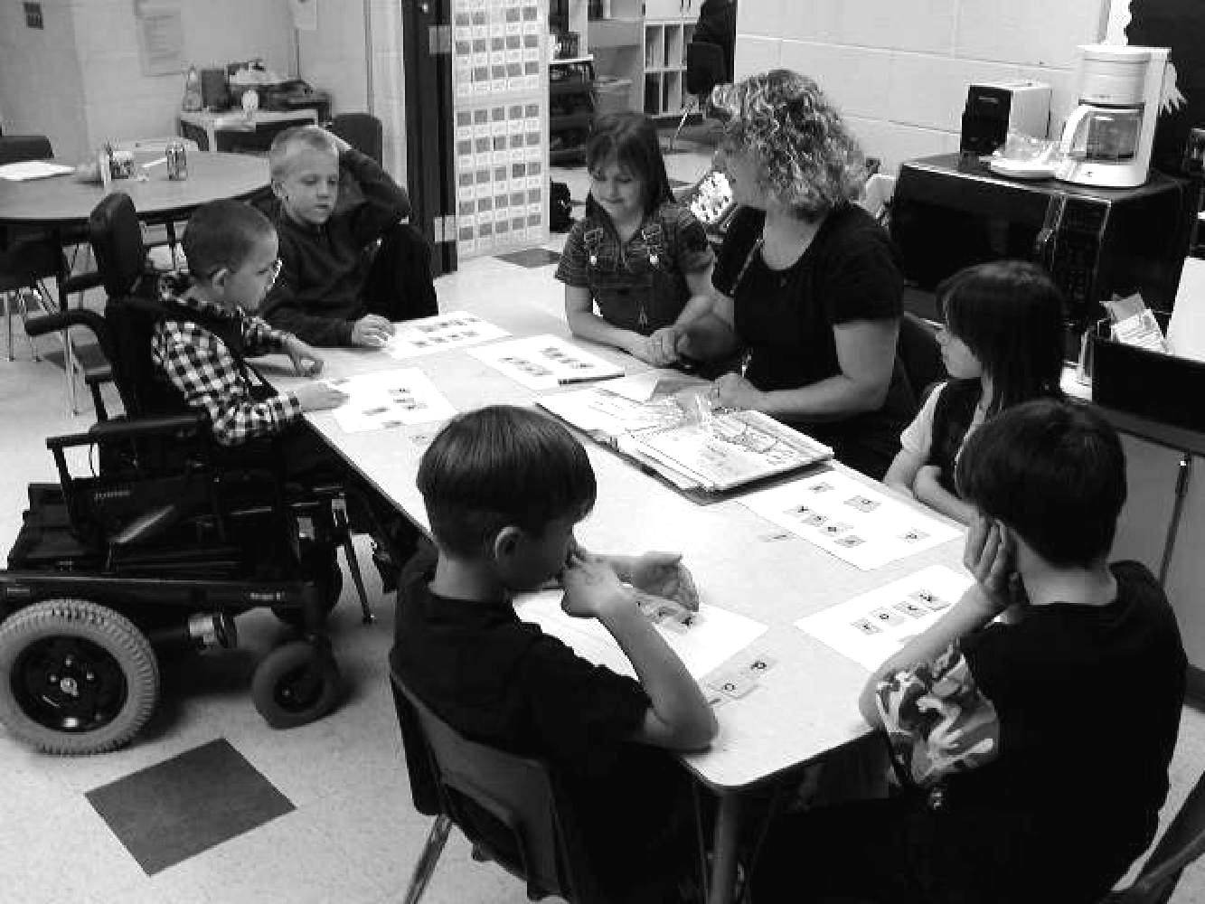
Research and Whole Schooling
All Students Benefit
Benefits for child with special needs
Greater academic expectations
Richer learning environment
More effective teaching strategies
Modeling by more able peers
Expanded friendships
Self-esteem and behaviors improve
Benefits for all
Increased appreciation and understanding of diversity
Increased academic progress
Expanded friendships
Richer learning environment

Slide 16
Journey into the Classroom
Whole Schooling in a
High School Government Class
Students read the text together
Use of graphics organizers to discuss prohibition
Students work in groups to act out the passage and removal of the prohibition amendment
Students create a song reflecting the meaning of major amendments
Jonathan, a student with a significant disability, is involved as the group asks him ‘yes’ and ‘no’ questions

Slide 17
CITIZEN
Why have school?
Have friends, be accepted
Feel good about themselves
Take initiative
Social roles - parent, worker, community member
Learn to solve complex problems
Make a difference in the community
WORKER
Learn to read, write, do math
Learn facts about science, social studies
Learn to follow directions
Learn to accomplish work tasks in a group
AND

Slide 18
Approaches to Learning
What Produces the Outcomes We Want?
Competitive - If we want students to learn to beat out others
Individualized - If we want students to only work alone and focus only on their own needs
Cooperative - If we want students to meet their own needs while caring about others - peers, family, community

Slide 19
Evaluating Success
In Learning and Achievement
Towards Personal Best Learning
TRADITIONAL: Same instruction for all - accept different outcomes
STANDARDS: Same standard for all - demand same outcomes
PERSONAL BEST, multilevel learning for citizenship - expect different outcomes based on individual excellence

Slide 20

Keys to Effective Inclusive Teaching
Personal best learning
Authentic
Multi-level
Instruction
Challenging teaching for all
Literacy, Math, Science,
Social Studies, Arts, PE
Support - Partnering
Support learning
Community
Democracy - Including All
Meet emotional needs
Inclusive Learning Environments
Space for All

Slide 21
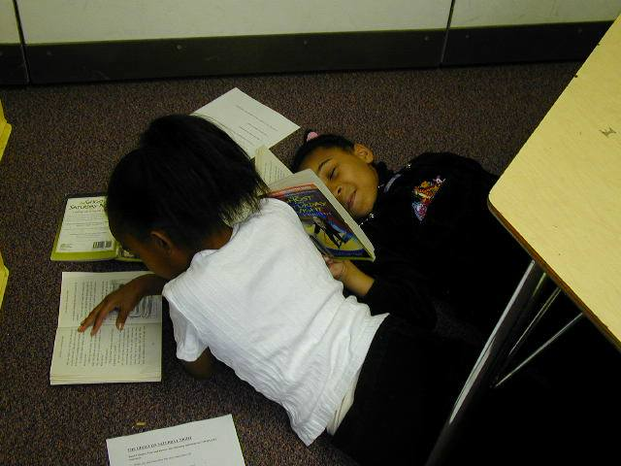
Keys to Effective Inclusive Teaching
Create Space for All in Learning
Arrange space and materials to . . .
Respond to varied learning styles
Facilitate social interaction and cooperative learning
Provide spaces for privacy
Allow movement
Encourage ownership of the classroom by the students

Slide 22
Keys to Effective Whole Schooling
Empowerment, Leadership, and Democracy
Learn about important community & social issues
Making the rules together
Learning to lead discussions
Daily decisions about classroom life
Choices in reading and class activities
Children working together
Collaboration among adults to support children’s learning

Slide 23
  FROM TOKENISM TO CITIZENSHIP
Youth initiated with mentoring by adults
Youth initiated with little adult involvement
Shared decisions with adults
Youth consulted & informed
Youth assigned but not informed
Tokenism
Decoration
Manipulation
LADDER OF EFFECTIVENESS
Roger Hart, 1997 UNICEF

Slide 24
Build Community and Meet the Needs of Children with Behavioral Challenges
Keys to Effective Whole Schooling
Celebrations & getting to know one another
Students design rules
Daily greetings & morning meetings
Cooperative learning
Peer tutors and buddies
Circles of support
Jobs in the classroom
Problem-solving class meetings
Peacemakers - conflict resolution
Commitment to children via positive behavioral support

Slide 25
Keys to Effective Inclusive Teaching
Include All in Learning Together
Children with vastly different academic, social-emotional, and sensory-physical abilities learn well together
Ethnic, racial, cultural, socio-economic diversity
Neighborhood school
Systematic heterogeneous grouping

Slide 26
Partner with Parents and the Local Community
Keys to Effective Inclusive Teaching
Parents feel welcome
Schools welcome all children - no fighting for inclusion!
Collaborative decision-makers
Space for parents in school
Invited to share and teach
Community as center of curriculum
Link school to community resources
School as community center

Slide 27
Keys to Effective Inclusive Teaching
Provide Support for Teachers, Students, and Parents
Support team
Collaborative Consultation
Co-teaching
Paraprofessionals
Community resources
Interagency support
Wrap-around services

Slide 28
SUPPORT STAFF TEAM
Collaborative consultation
Routine meetings for planning
Coordinating support staff among teachers
Crisis team support

Slide 29
Keys to Effective Whole Schooling
Utilize Authentic, Multilevel Instruction
Open-ended, authentic learning projects - engaging and real world
Higher order learning goals
Students of different abilities learn together in heterogeneous groups
Just right work
Learning materials at different ability levels
No stable ability grouping
Grade based on effort & meeting learning goals
Portfolios and rubrics

Slide 30
Keys to Effective Whole Schooling
Use Authentic Assessment To Promote Learning
Competency assessments observations, performance and work sample assessments using rubrics
Portfolios
Self-assessment
Publishing student work
Student-led conferences
Multi-modal demonstrations of learning – story, illustration, skit, song, poem, etc.
Focus on effort, goals, growth

Slide 31
Bumps in the Road
Segregating Students Within the Classroom
Specialists may pull students out of the classroom or off to the side essentially segregating students in the classroom
Specialists may not understand the curriculum and how to co-teach with the general education teacher
What to do?
  Be clear about expectations of specialists that they work with you in developing multilevel, inclusive lessons
  Initiate conversation regarding their roles - provide ideas
  Specialists look for ways to have student’s special needs met within the general education curriculum

Slide 32
CHAMPIONS OF INCLUSION CONNECT
with students who have disabilities as individuals who are contributors first.
Champions of inclusion are:
the classmates who describe Victoria as a good friend who has started skiing and who drives a cool wheelchair;
the English teacher who depicts Johnny (who has learning disabilities) as a kid who writes great stories using that special computer program;
the teacher aide who brags about how terrific a job Chuck (a boy with cognitive delays) has done combining geometric shapes;the music specialist who relates how fantastically Ashley (who has autism) sings during performances;

Slide 33
  Designing Inclusive Instruction & Response to Intervention (RTI)
TIER III
Differentiation
& Formal Services
10-15%
TIER II
Individualized Differentiation
10-15%
TIER I
Universal Design for Learning
75-80%

Slide 34
Universal Design and Individual Interventions
Three Key Domains
 | Physical | Social– Emotional | Academic
Universal Design for Learning (Tier I) | - Heterogeneous grouping - Use multiple learning modalities | -Promote caring -Encourage friendships -Teach social skills and “emotional intelligence” | -Promote authentic learning -Recognize multiple intelligences -Devise multilevel lessons
Individualized Differentiation (Tiers II & III) | - Obtain a talking computer for a blind student - Rearrange books so a student in a wheelchair can reach them | -Understand needs and communication -Provide positive alternatives -Create a circle of friends to assist student | -Offer advanced projects -Provide additional help and support -Read stories to students with reading difficulties
Evaluate & Revise | - Use talking computers for all students | -Use circles of friends to build community | -Read stories to all students

Slide 35
Contrasting Approaches
Traditional ‘pre-referral’ strategies
Teachers expected to try different approaches
Specialists may consult with teacher
Seen as one more bureaucratic hoop before the referral is processed
Inclusive response to intervention strategies
Specialized support staff provide ongoing assistance to teachers
Specialists have caseload of students with IEP’s but also work with students who are struggling
Collaborative consultation action planning
Lower referral rate

Slide 36
Whole Schooling Strategies
in an Elementary School
A specialist, drawn from several categorical programs, is assigned to each grade-level team to provide in-class support for teachers.
Teachers and specialists work together as a team to assist all children at a grade level.
“Sacred time” is established to create uninterrupted academic learning.
A ninety-minute planning block is set aside for grade-level teams and an additional sixty-minute planning block with specialists each week.
Flexible instructional groupings ensure heterogeneous grouping and prevent stigmatization of students.

Slide 37
Whole Schooling in a High School
Every student can access general and special education teachers for assistance
Special education teachers provide in-class support for all students.
Classes encourage peer support and collaboration
Special services are organized according to the school structure (e.g., departments, knowledge base groups, academic families, academies).
Class time is longer (ninety minutes)
Curriculum is planned for all students and accommodations are provided for those students who need them.
Teachers are provided with professional development resources

