Slide 1
Chapter 13 Inclusive Academic Instruction Part III
AUTHENTIC MULTILEVEL INSTRUCTION
Applications in Subjects

Slide 2
Inclusive Literacy in Action
Joanne Butler’s 1st grade
Reading ‘just right’ books
Individual, pairs, sharing about books
Based on interest
All challenged at their level
Skills via mini-lessons
Akio Kudo’s HS literature class
Colonialism and apartheid in S. Africa
Students proposed projects that they carried out
Students with special needs participated fully

Slide 3
Sights to See
Inclusive Academics in Action
Inclusive Reading Workshop
www.wholeschooling.net/WS/Video/Read workshop MH.html
Cooperative Arithmetic
http://www.edutopia.org/math-social-activity-sel-video
First-Class Citizens
www.edutopia.org/first-class-citizens-video

Slide 4
Inclusive Academic Instruction
Science
science for ALL
meaningful understanding
Literacy
thematic units
choral reading
journal writing
Physical Education
integration
Unified Sports
Mathematics
exploration and alternative strategies
manipulatives
discussion
listen, coach, and reflect
Arts and Music
integration
a way of life

Slide 5
Literacy and Language Arts
What Is Literacy?
Using Multiple Communications Systems
Reading by which individuals construct meaning from print using their prior knowledge.
Writing text in words.
Speaking and listening.
Viewing.
Representing, either physically, in drama, movement, or in pictures.
Signing, facial expression, and gestures of hands, legs, or other body parts.
Using technology to access to written and graphic materials and to communicate.

Slide 6
Literacy and Language Arts
Challenges in Literacy Education
Debate over good instruction - isolated skills (phonics, phonemic awareness) apart from actual reading and writing
Instruction of skills based on reading nonsense words, individual direct instruction, worksheets
Need: students to spend time actually reading and writing while developing skills
Students with literacy challenges give up

Slide 7
Literacy and Language Arts
Standards in Literacy Learning
Students read a wide range of literature and to develop understanding & experience personal fulfillment
Students learn to use many strategies drawing on their prior experiences and knowledge
Students learn to vary their use of language to communicate with different groups of people
Students learn to use language conventions (eg. spelling, punctuation, etc.)
Students research issues by developing questions, posing problems, and gathering information
Students use a range of information resources to gather information
Students use language to achieve their own goals, to learn, persuade, and share information and ideas

Slide 8
Literacy and Language Arts
Reading Workshop
Reading assessment
Instructional read aloud
Individual reading of ‘just right’ books
Book clubs: student dialogue and sharing of books
Mini-lessons and guided reading in small groups to work on reading strategies
Assessment to demonstrate comprehension and understanding

Slide 9
Literacy and Language Arts
Reading Workshop Cycle
Choose a Just Right Book
Prove it is Just Right to the Teacher and set a due date
Read the book- marking comprehension strategies with sticky notes
Do a writing page that answers questions about the book
Have a student orally test you on the book
Take to teacher for a conference
Choose another Just Right Book

Slide 10
Literacy and Language Arts
Strategies for Comprehension
Making connections
Asking questions
Sensory images
Determining importance
Inference
Synthesizing

Slide 11
Literacy and Language Arts
Writing Workshop
Assessment of student writing abilities
Developing ideas for writing in a writer’s notebook
Mini-lessons on craft and editing ideas
Individual writing work
Students review drafts and provide feedback
Editing
Publishing
Sharing

Slide 12
Literacy and Language Arts
Teacher Responsibilities in Writing Workshop
Set goals with students for a new piece of writing
Meet with a small group for a mini-lesson on a related topic
Model a type of writing on the overhead
Identify students who have excellent examples of a strategy, topic, or skill being worked on to share with other students

Slide 13
Literacy and Language Arts
Teaching Skills: Spelling, Phonics and Grammar
Teaching phonics is NOT teaching reading
Reading has to do with finding meaning in text
Mini-lessons: a few examples
Practice reading words with target skills
Crossword puzzles of words with target skills
Games to practice sound or spelling
Display high frequency words nad have students practice saying and spelling with clapping, snapping of fingers, etc.
Scavenger hunt / word search
Word sort

Slide 14
Literacy and Language Arts
Individualized Differentiation
Use multiple intelligences
Multilevel reading materials in the classroom
Individualized differentiation in reading
Help students read books at their ability level
Pair students for reading books they like
Have older students read to youngers
Have many good books with many pictures available
Use all 4 ways to ‘read; (1) pretend read familiar books; (2) picture read; and (3) listen to book via CD or a reader; (4) read words of the text
Use assistive technology

Slide 15
Literacy and Language Arts
Individualized Differentiation
Individualized differentiation in writing
Help students read books at their ability level
Pair students for reading books they like
Have older students read to youngers
Have many good books with many pictures available
Use all 4 ways to ‘read; (1) pretend read familiar books; (2) picture read; and (3) listen to book via CD or a reader; (4) read words of the text

Slide 16
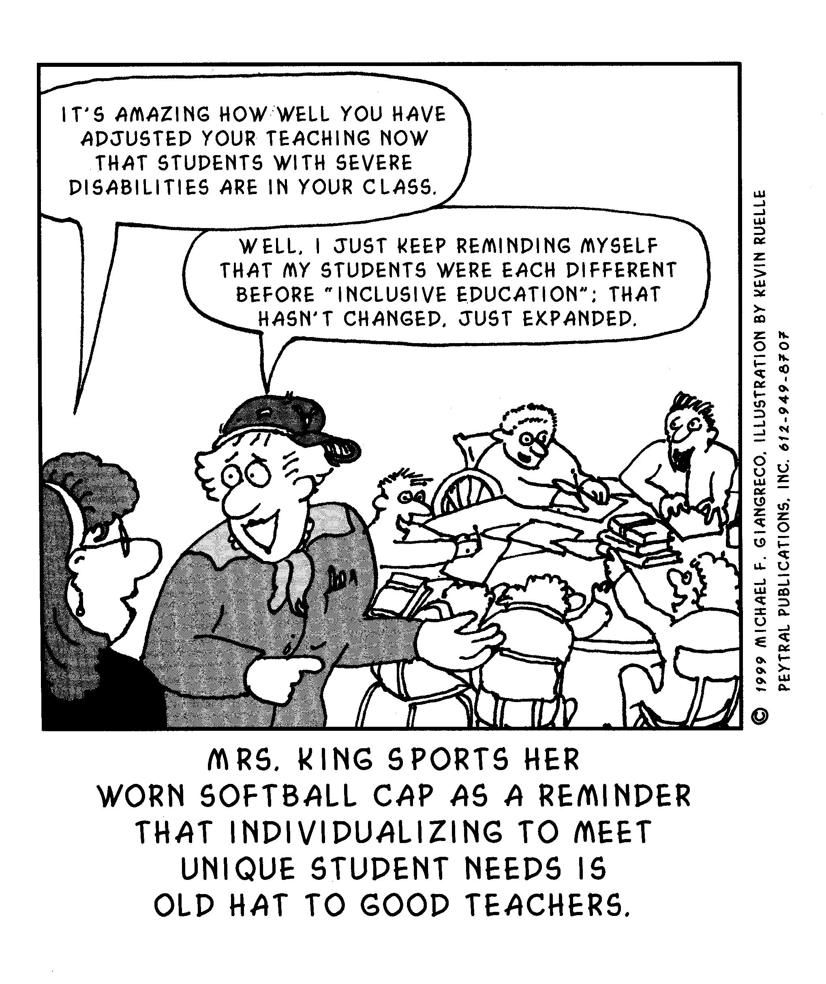

Slide 17
Mathematics
Challenges in Mathematics Education
Many students don’t like math
Mathematics is typically taught as an increasing list of skills with little to no focus on use of math in real life
Focus on ‘getting the right answer’ rather than really understand mathematical concepts

Slide 18
Mathematics
Standards in Mathematics Education
National Council of Teachers of Mathematics
3 key features:
Knowing mathematics is doing mathematics related to a purposeful activity
Understanding mathematics shifts from the traditional sequence of algebra-geometry-pre-calculus to understanding mathematics in ways that can be applied to many disciplines
Use of technology must be integrated into mathematics education including calculators and computers

Slide 19
Mathematics
Standards in Mathematics Education
National Council of Teachers of Mathematics Key practices:
More time for students to explore and invent alternative strategies
Increased focus on concrete experience
Discussion among students regarding mathematics problems
Emphasis on taking students’ thinking seriously—listening, coaching, reflecting, and challenging

Slide 20
Mathematics
Inclusive Mathematics Instruction
Daily Lesson Format for Workshop Learning
Mix of whole group, small groups, and individual work
Begin with whole class to connect, give directions, and provide a mini-lesson
Students work indivually, in pairs, or small groups on learning projects
Pull small groups together for mini-lessons as needed
Provide support for individual students

Slide 21
Mathematics
Inclusive Mathematics Instruction
Key Strategies:
Emphasize Conceptual Understanding by Emphasizing “Big Ideas”
Make Connections Between the Real World and the Use of Mathematics
Link Mathematical Learning to the Interests of Student and the Local Community
Move from the Concrete to the Representational to the Abstract

Slide 22
Mathematics
Inclusive Mathematics Instruction
Key Strategies:
Use Multiple Representations, Manipulatives and Other Concrete Materials
Authentic Multilevel and Tiered Lessons
Create Understandable and Clear Math Problems
Listen Carefully to Students and Recognize Emerging Understandings
Create a Sense of Safety, Community, and Belonging
Have Students Reflect on the Meaning and Use of Mathematics

Slide 23
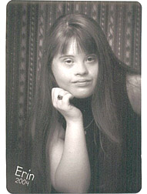
Journey Into the Classroom
Reflections On This Year’s Journey
VISION: To have reciprocal relationships with friends; to communicate and advocate for herself. What has happened?
The independent creation of her “commercial” for ecology – “Don’t smoke! Yucky, Gross, Ugly! So there!” – that became the creative idea for her science group.
Three great speeches on Erin’s favorite topics in English.
Choir! Choir! Singing in choir! Practicing for Choir! Erin’s private singing lessons which she loves too.
Ushering at plays – and then getting to watch them too.

Slide 24
Journey Into the Classroom
Reflections On This Year’s Journey
VISION: To have a life in a community that values diversity and accentuates strengths and to contribute to that community. What has happened?
Erin’s excitement about sitting with friends at lunch and sharing about events with friends in our talks each day after school.
Being a “Dancing Tree” in the English class Mythology Play.
“Her interest and enthusiasm has spilled over into the classroom and is a stimulus for other students.” Ecology Teacher

Slide 25
Journey Into the Classroom
Reflections On This Year’s Journey
VISION: To have the same opportunities as any other person to learn and participate in typical classroom, extra curricular, and community activities. What has happened?
When Erin turned on the bathroom fan/light and came running out to tell her Dad and me about the air going out of our house, just like she had learned about in Ecology that day.
Doing well with vocabulary games and on geography maps.
Observing Erin easily maneuvering computer tools on a measuring program in math.

Slide 26
Science
Challenges in Science Education
Focus on use of textbooks, lectures, and worksheets
Emphasis on memorization of facts rather than understanding or learning how to conduct research
Students consequently lose interest in science education and learning is inadequate

Slide 27
Science
Standards for Science Education
Students must do science by conducting scientific inquiry not just cover topics
Students should use a variety of scientific approaches and tools
Teachers must focus on helping students develop fundamental concepts and the big ideas of science, not just memorizing facts
Students learn via collaborative group work
Assessment must focus on student’s understanding and engagement in scientific processes not just the recall of facts

Slide 28
Science
Inclusive Inquiry Learning in Science
Authentic, Interdisciplinary Themes
Inquiry Lessons
Introduce the lesson or unit
Help students generate questions and a hypothesis
Facilitate student planning of an experiment
Students conduct the study to gather and analyze data and information
Students communicate and share results
A few examples
Layers of the Earth: Small Group Multilevel Project
Exploring Sound: Multiple Intelligence Centers
Making a Light: Small Group Multilevel Project
Understanding Density: A Tiered Lesson

Slide 29
Bumps in the Road
Gifted Students and Inclusive Classes
Some educators and parents believe that gifted and talented students must be in separate programs to be challenged
Others believe that these students can be challenged in inclusive classes and that learning how to interact with those with less abilities is a critical part of these students’ education (talent development for all)
Multilevel teaching can provide challenges and support at all levels
Students who are gifted can learn many important leadership skills in inclusive classes

Slide 30
Social Studies
Challenges in Social Studies Education
Many disciplines involved
Heavy traditional reliance on textbooks, lectures, and multiple choice tests
Emphasize on memorization of facts rather than understanding, problem-solving, and engagement

Slide 31
Social Studies
Standards for Social Studies Education
Students should investigate important topics in depth rather than having cursory ‘coverage’
Students should be involved in inquiry involving open-ended questions
Social studies learning should involve community connections and participation
Students should use original source materials, not just textbooks
Students should engage in dialogue, engagement, and debates
Assessment should focus on key skills and attributes of citizenship, not the recall of facts

Slide 32
Social Studies
Inclusive Social Studies Learning
Some key strategies
Studying and Acting on Issues
Acting Out History
Using Trade Books and Original Source Material
Use technology

Slide 33
Arts and Physical Education
Challenges
Teachers often feel they are not as valued as ‘academic’ teachers
In some schools students with special needs are only included in these ‘specials’
Arts and physical education are often tied to high degrees of competition with other schools in middle and high school
Segregated arts and physical education programs separate students with special needs

Slide 34
Arts and Physical Education
Standards
Students should do the arts, not just view or listen to them
The arts should be integrated into all subjects with all teachers engaging the arts
Students should have choices, be nurtured to find their strengths, creating their own form of expression via the arts, and share their products and performances with others
Students should be involved in the world of the arts, experiencing various art genres, and connecting with arts events and artists

Slide 35
Arts and Physical Education
Inclusive Instruction
Involve Students in Doing Art and Physical Education
Use Assistive Technology
Cooperative Physical Education Games
Inclusive Competitions - Unified Sports and more
Arts and Physical Education in All Classes

Slide 36
Back Pack
It’s Just Good Teaching
It’s Just Good Teaching - inclusive math and science classes
www.nwrel.org/msec/resources/justgood.php
Annenberg Media
www.learner.org

