Slide 1
Chapter 11 Inclusive Academic Instruction, Part I
Plan Inclusive Lessons and Units

Slide 2
Donald Participating in an Inclusive Class
Donald uses alternative communication tools with help from his friends
Sylvia helped Donald with the maps project
A class discussion about diversity - student said they have learned much from having Donald in the class
They were experiencing diversity and learning how lessons can be structured for people with a range of abilities

Slide 3
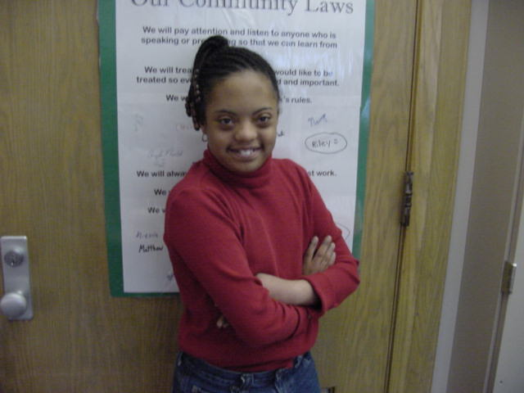
SYDNEY’S MOOSE PROJECT

Slide 4
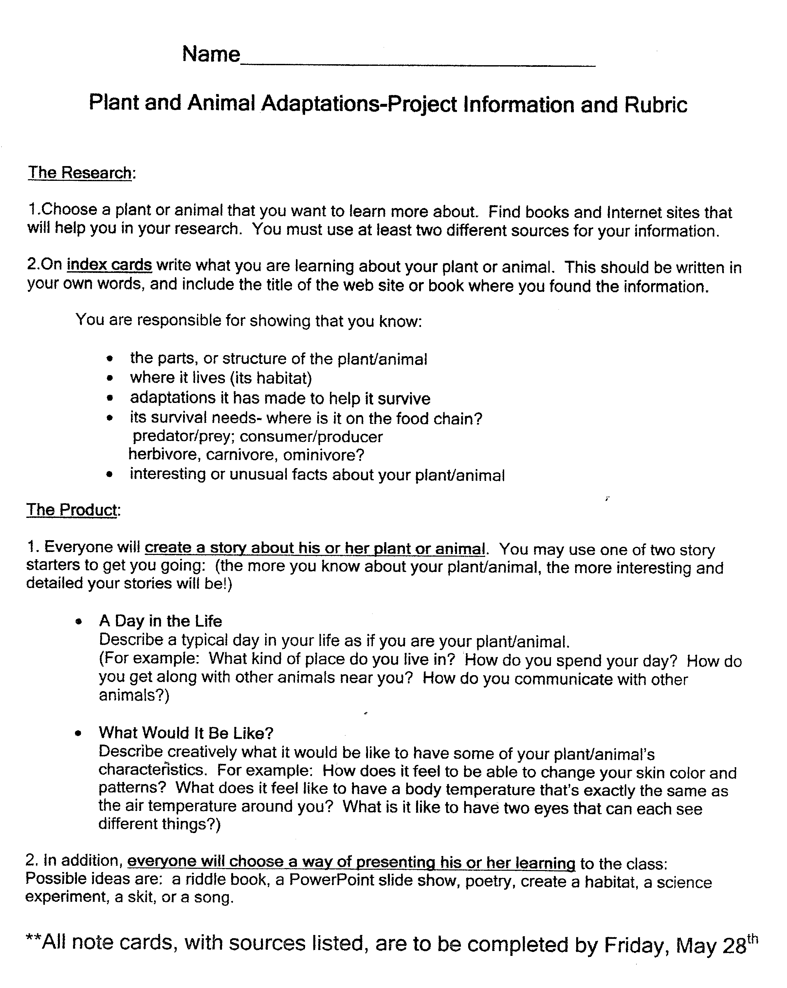

Slide 5
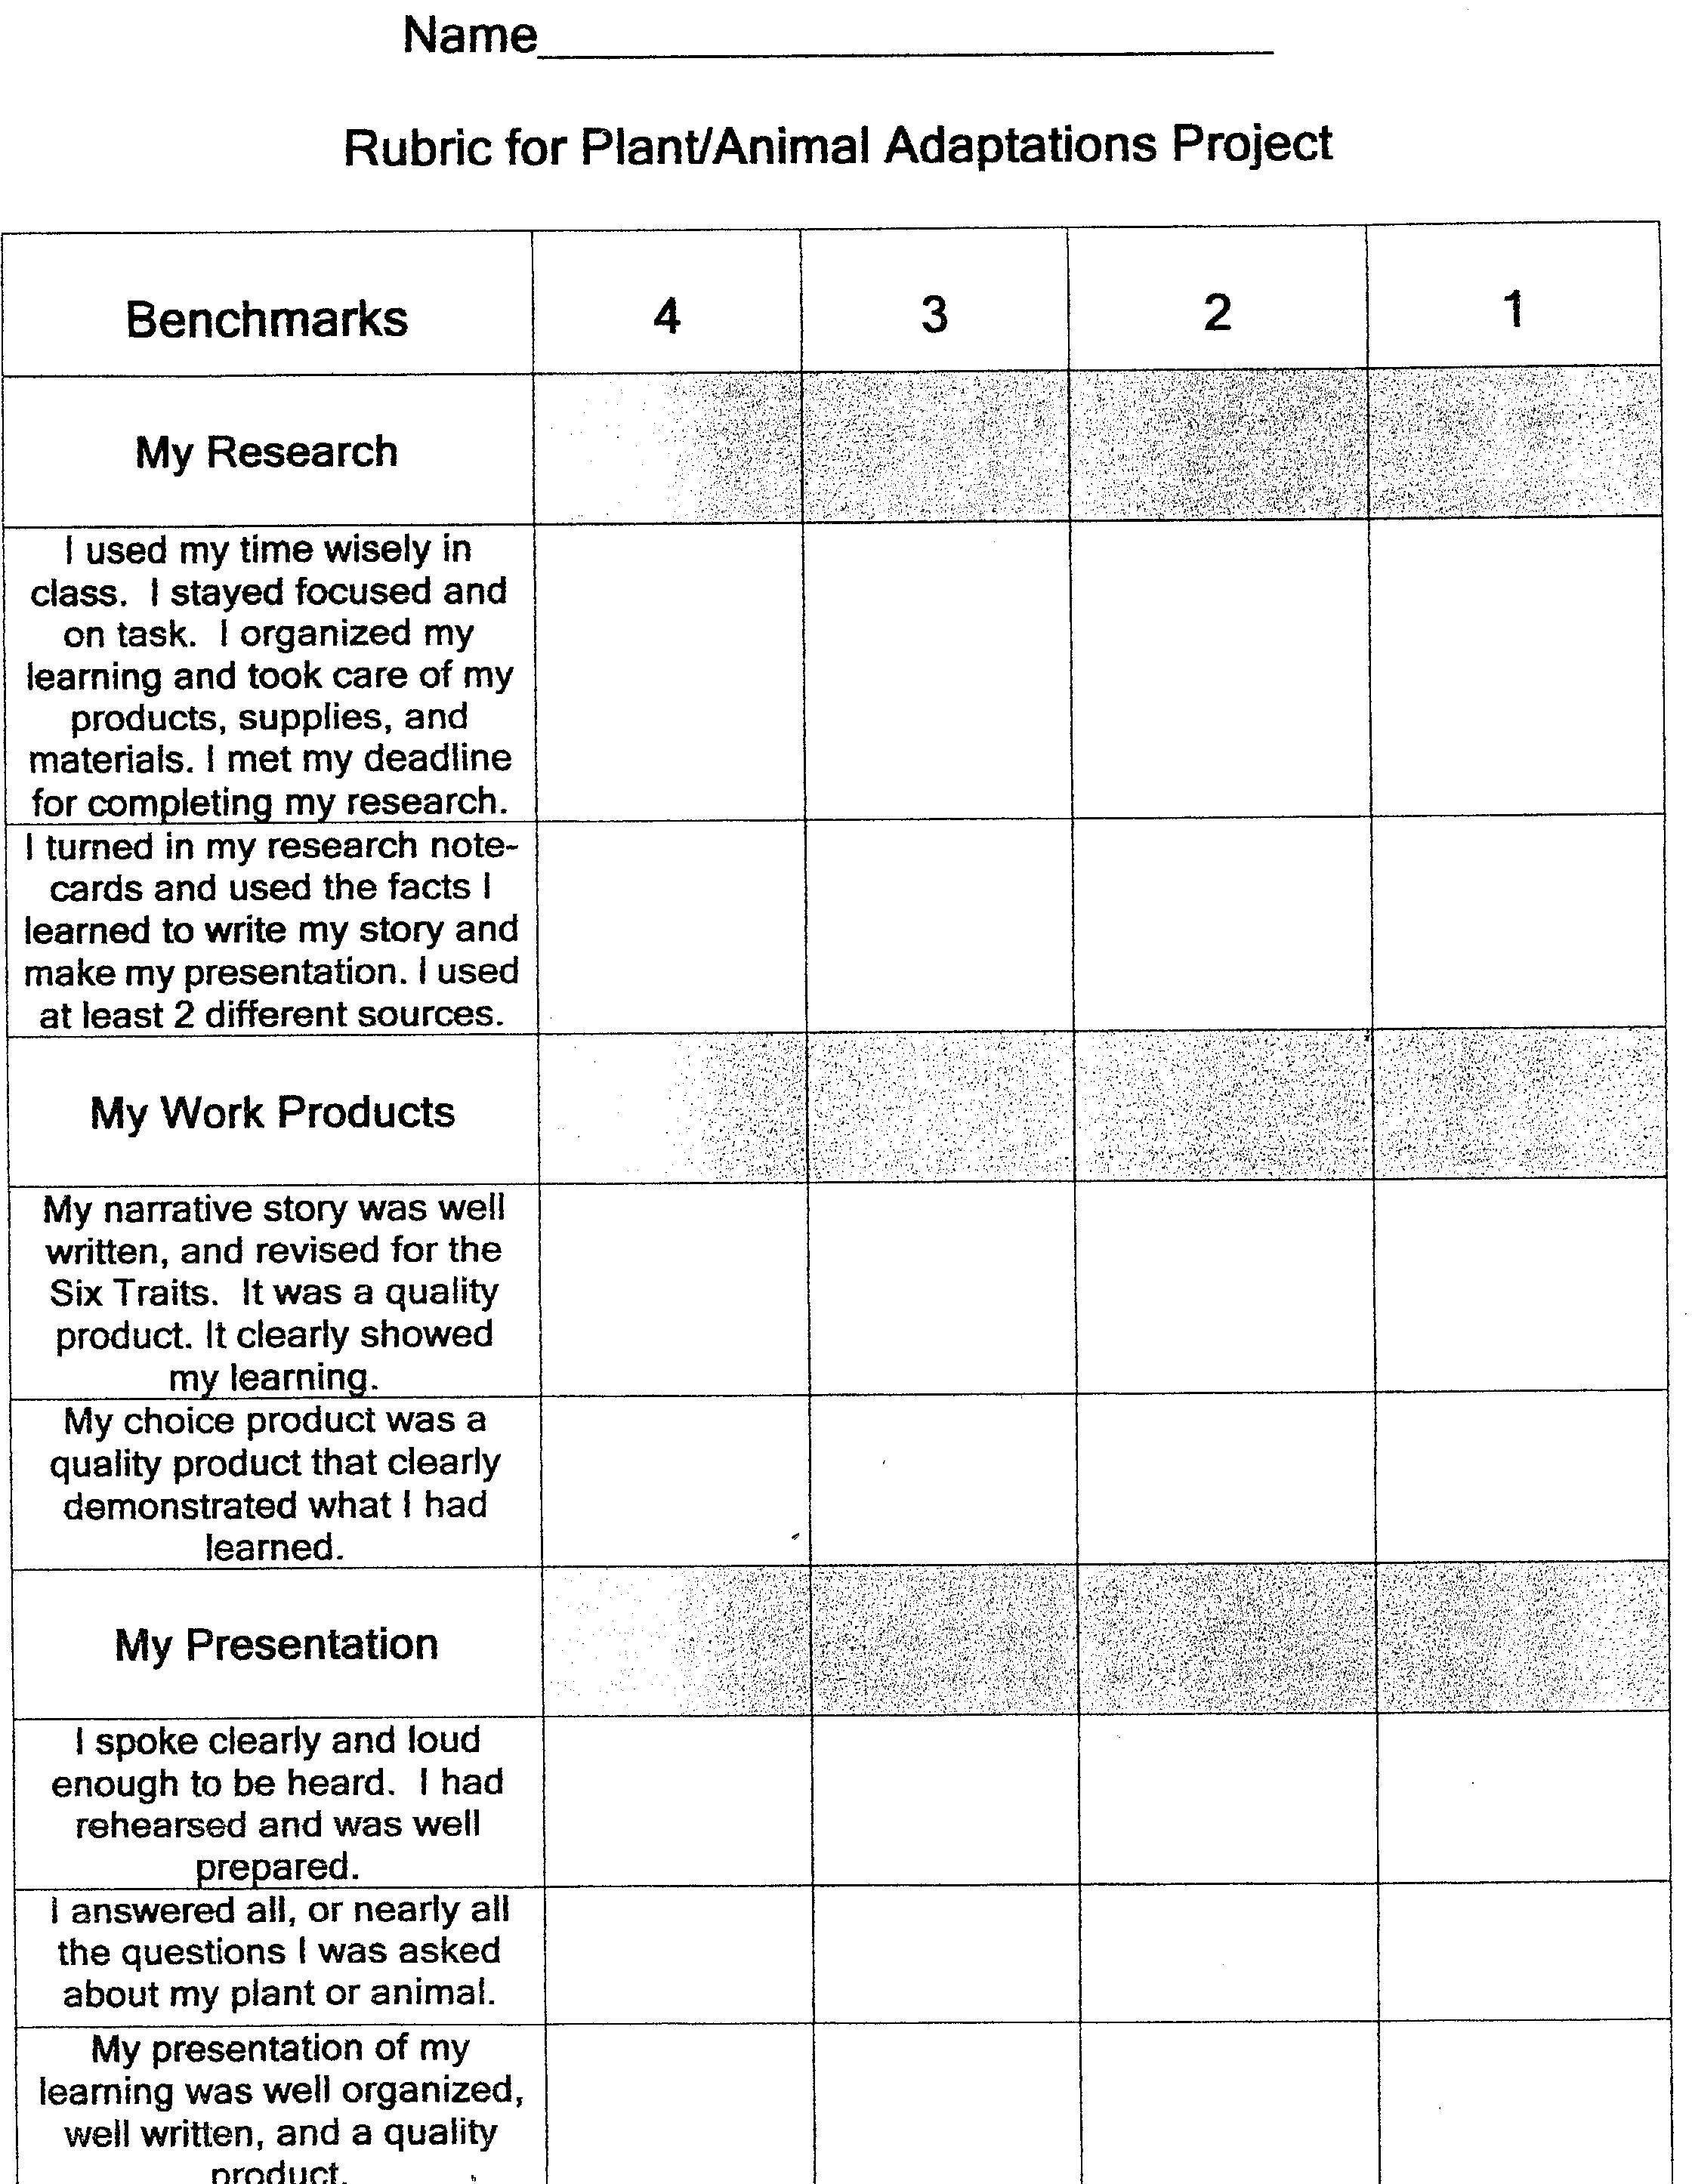
PROJECT RUBRIC

Slide 6
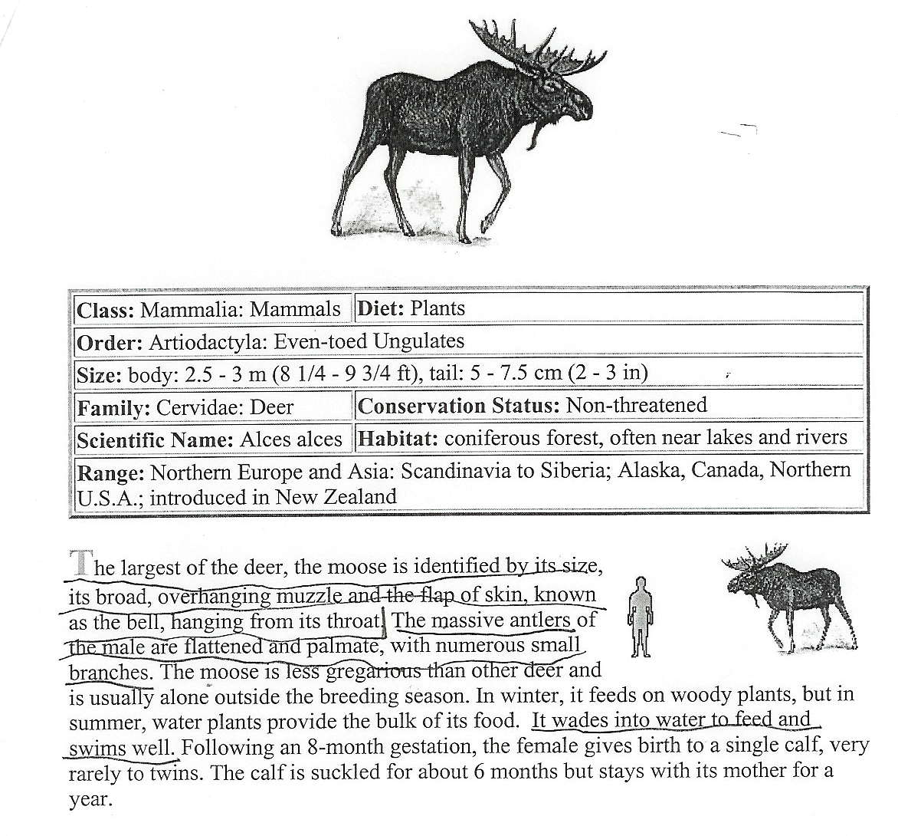
INTERNET RESEARCH

Slide 7
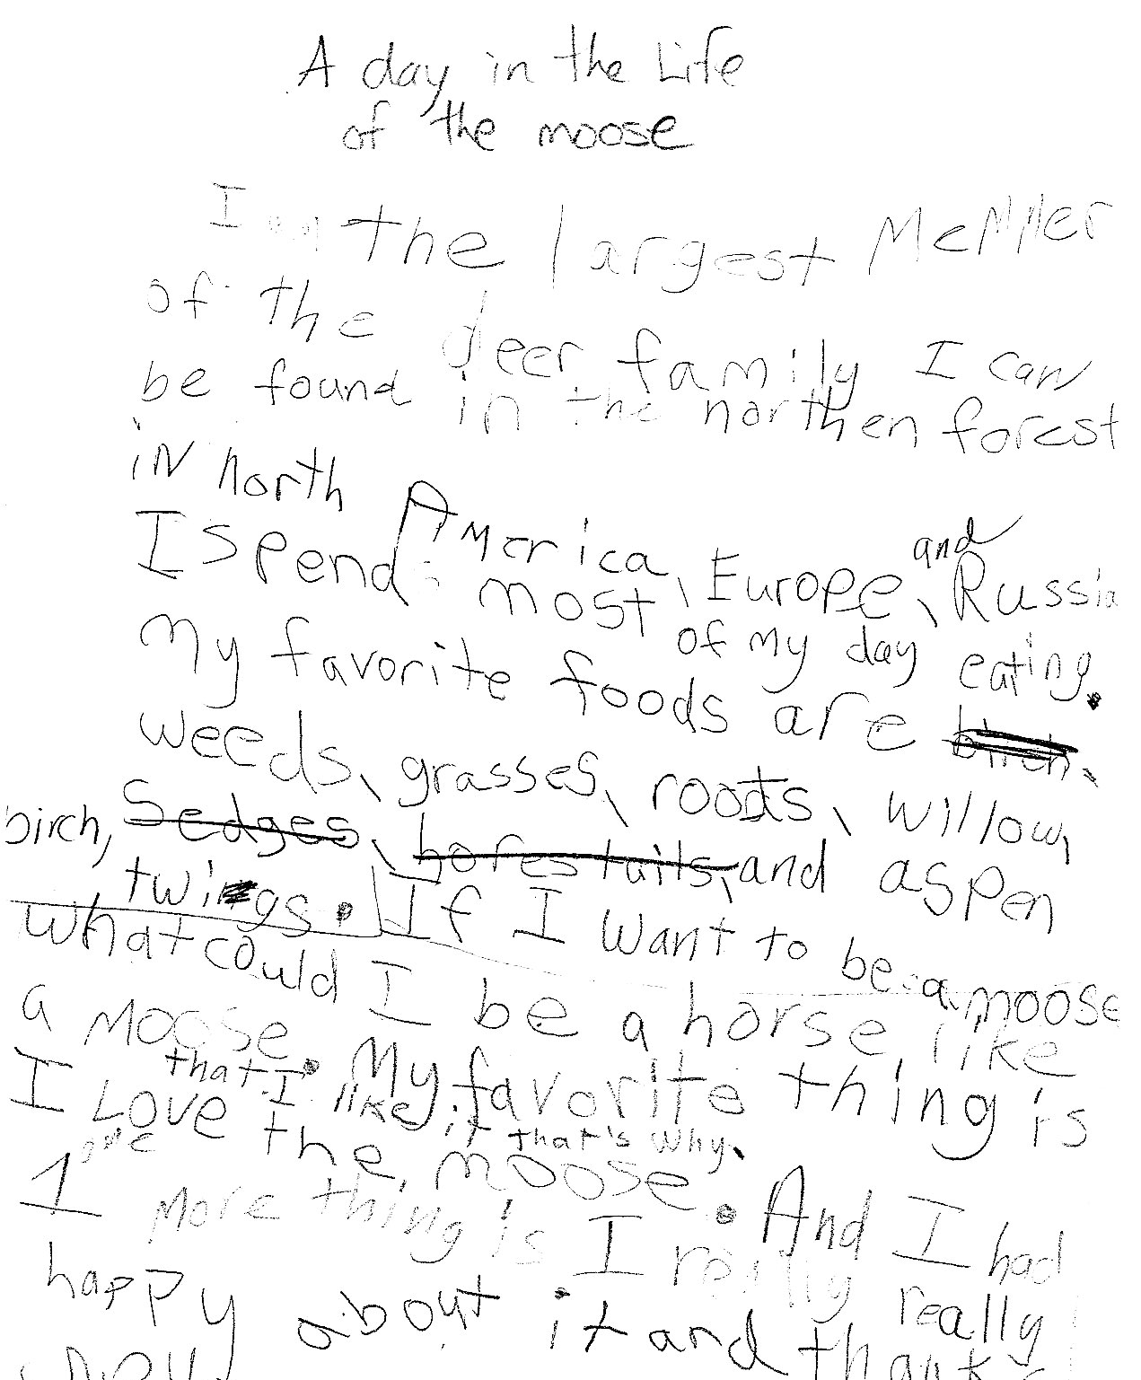
First Draft of Report

Slide 8

Final Report

Slide 9

HAVING SUCCESS!

Slide 10
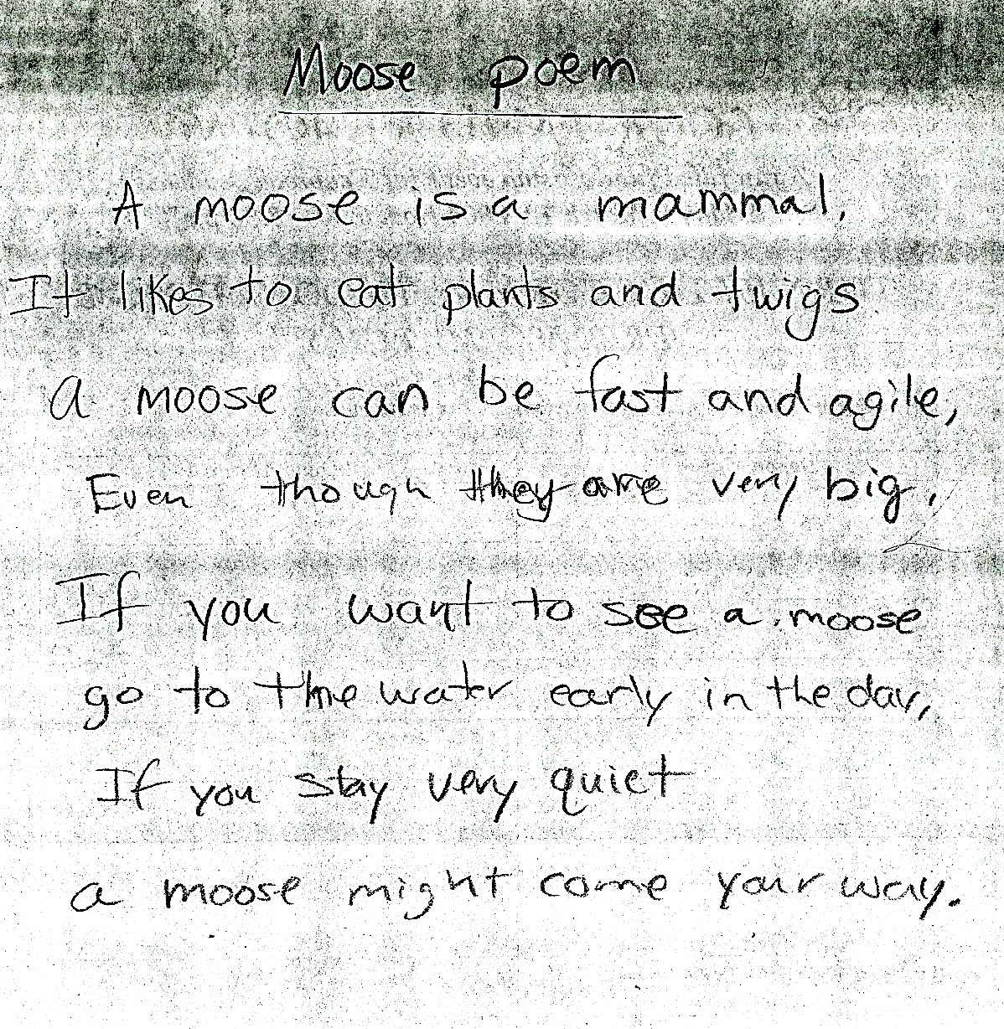
2nd Draft
MOOSE POEM

Slide 11

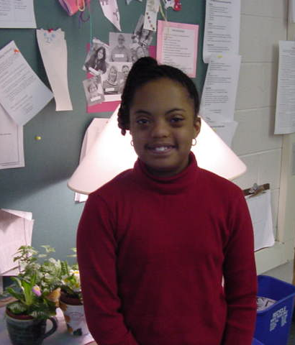
By Sydney Jones

Slide 12
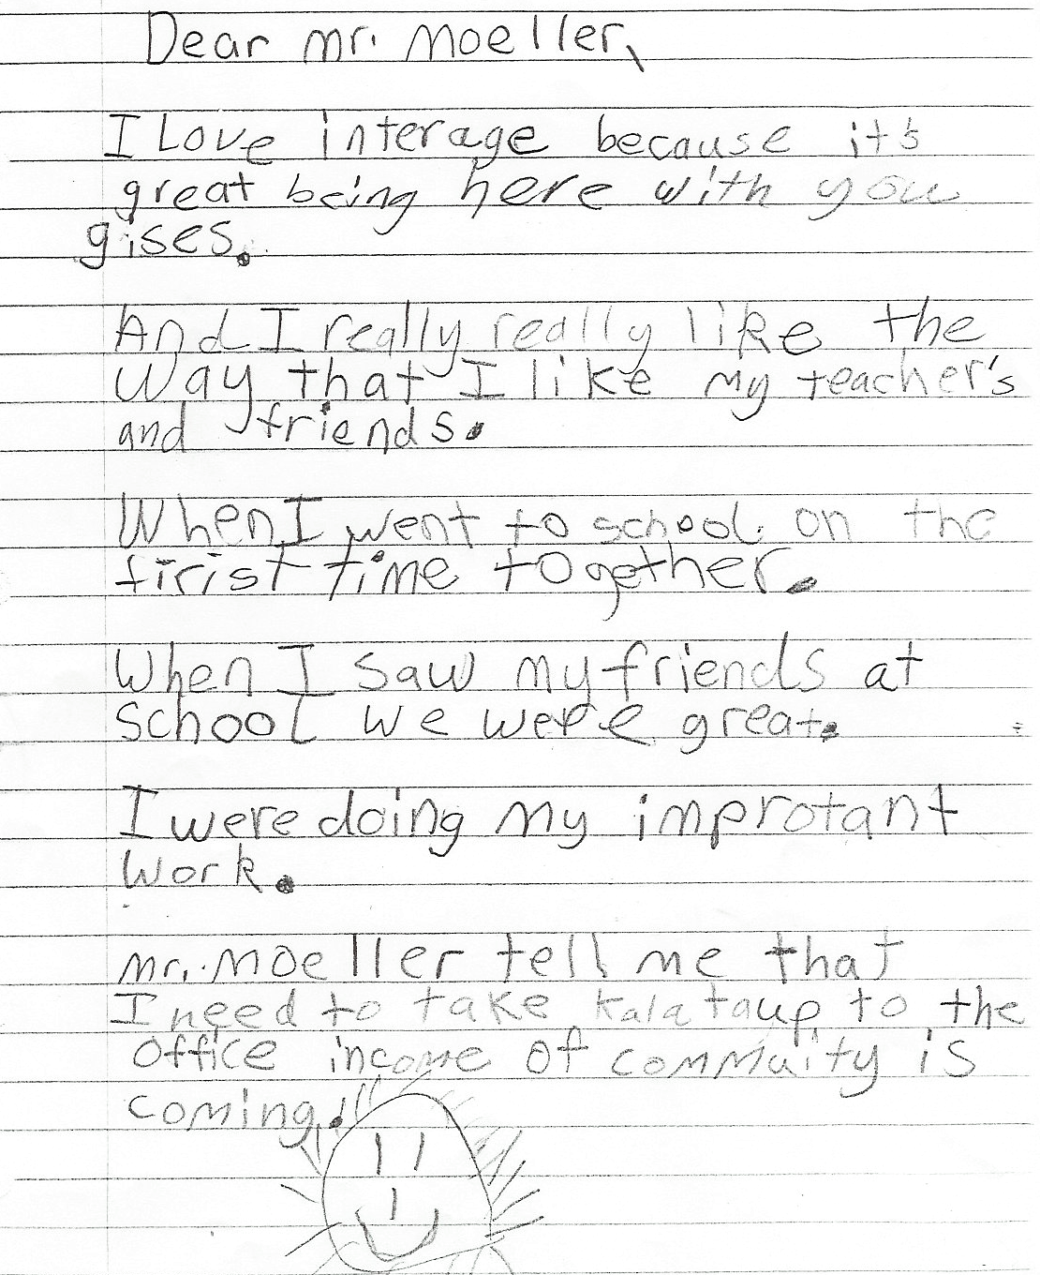
Sydney’s letter to her teacher

Slide 13
Sights to See
Learning Styles and Assistive Technology
Knowing How You Learn
www.edutopia.org/knowing-how-you-learn
The Sound of Learning: Albano Berberi
www.edutopia.org/assistive-technology-albano-berberi-video

Slide 14
Disabled Curriculum and Instruction
‘Official’ and ‘Classic’ Theories of Learning
The factory model of schooling is still with us! Kids in rows, lectures, worksheets, multiple choice tests
Official theory of learning - hard work, dependent on rewards and punishment, individual, easily forgotten
Classical theory of learning - we are always learning, effortless, being with others to learn, authentic.

Slide 15
Disabled Curriculum and Instruction
Problems with the Official, Traditional Approach to Learning
Emphasis on memorization engenders little understanding, leading to shallow understanding and lack of motivation
Mastery and use of skills seen as separate disconnecting students from the real world
Teaching materials (textbooks) at one level, thus frustrating to many students
Students are largely in passive roles (eg. listen to a lecture)
Instruction is seen as an individual enterprise and get in trouble when they interact with others
Students make trouble to make the class more interesting
Assessment and evaluation is based on low levels of skills that don’t require real understanding

Slide 16
Three Fundamental
Approaches to Instruction
Lecture - test - worksheet
Direct instruction - direct teaching of skills out of the context in which they are used
Workshop learning - involving students in authentic, real world activities investigating critical questions, creating products to demonstrate learning

Slide 17
Brain-based Learning
Key Understandings About Learning and the Brain
The brain simultaneously makes connections between multiple ideas and engages in many activities and thought processes at once
The brain processes parts and wholes at the same time
The search for meaning is fundamental
Emotion and cogntive learning are hard-wired

Slide 18
Brain-based Learning
Key Practices
Ensure a state of relaxed alertness in a challenging but non-threatening environment. Ensure a state of relaxed alertness in a challenging but nonthreatening environment.
Orchestrate immersion in complex experience
Continuously engage in active processing of experiences to consolidate emerging mental models.

Slide 19
Emerging Standards For
Teaching & Learning
We need MORE . . .
Hands-on, experience-
based learning
Active learning --
students moving, talking.
Real books, authentic experiences
Deep thinking.
Choices & democracy --
students help make decisions
about the class.
Collaborative, cooperative work.
Heterogeneous grouping.
Building sense of community.
We need LESS . . .
Lecture, whole class.
Passivity -- “sit, listen,
be quiet, do your work.
Worksheets, basals, dittos, textbooks.
Rote memorization.
Tracking, ability grouping.
Competition.
Standardized tests.
Emphasis on grades.
Focus on compliance.

Slide 20
Culturally Responsive Pedagogy
Positive perspectives on parents and families
Communication of high expectations
Learning within the context of culture
Student-centered instruction
Culturally mediated instruction
Reshaping the curriculum - meaningful, student-centered, and interdisciplinary
Teacher as facilitator

Slide 21
Universal Design for Learning
Use multiple ways to present information
Provide multiple pathways for students’ action, expression
Provide multiple ways to engage students including collaborative, interactive structures

Slide 22
Differentiated Instruction
Content
Process (of accessing information)
Product (ways in which learning is demonstrated)
Based on the students readiness, interest, and learning profile

Slide 23
Authentic Multilevel Instruction
Authentic
Engaging higher order thinking
Inclusive
Multi-level
Multi-modal
Scaffolding
Guided student leadership and direction
Evaluation based on learning and growth

Slide 24
CHAMPIONS OF INCLUSION COLLABORATE with others to maximize students’ development
Some examples
Classmates who meet with Sammy (who has lost some mobility from an accident in his friend’s car) to discuss ways of supporting him
The special education teacher who designs adapted activities for an astronomy unit with the grade 4 teacher who includes students with various disabilities
The early childhood teacher who discusses with her part time teacher’s aid better ways of engaging with Keisha (who is nonverbal) in play activities
Carlos (who is a blind high school student) who volunteers to tutor a struggling grade 2 reader in an after school program using appropriate level print Braille books

Slide 25
Steps for Planning
Authentic Multilevel Instruction Units and Lessons
Step 1: Select an authentic, interdisciplinary theme
Step 2: Develop multilevel learning goals
Step 3: Design product, assessment, and evaluation
Step 4: Engage students in authentic multilevel learning activities using workshop-based learning
Step 5: Differentiate lessons for individual students

Slide 26
Step 1. Select an Authentic, Interdisciplinary Theme
Theme - a unifying topic regarding something in the real world
Authentic - engaging students in tasks related to real life. Two key aspects:
Topic of focus - of interest in the real world
Method of engaging students - real audiences, people involved in the topic, real places

Slide 27
Advantages of Authentic Learning
Promotes higher-order thinking
Seeks depth of knowledge (fewer topics are engaged in greater depth)
Engages students in connecting to the world beyond the classroom
Encourages student construction of knowledge

Slide 28
Examples of Interdisciplinary Authentic Lessons
A student interviews individuals he considers “heroes” and learns about their lives, developing written materials, a poster, a video, or another depiction
A student’s grandparents visit from a country that is in the midst of war. The class studies the country and class members write letters welcoming the grandparents to the United States.
A local industry has just closed, and many people have been laid off. At the same time a new shopping mall is opening and a high-tech industry is being built in a nearby town. A high school class studies why this is happening.

Slide 29
Strategies for Creating Interdisciplinary Themes
Consider: How long do you want your thematic lessons to last?
Focus on science and social studies for topics
Engage students in dialogue and discussion about their interests
When you have a topic, provide a short description
Use a curriculum web to show many sub-topics and how they relate to one another; use the web to link each of the subjects to the theme

Slide 30
Involve Students in Selecting Topics for Learning
Break students into pairs, have them interview each other, and publish the interviews as part of a class newspaper.
Ask students to interview their families and write “family stories” to share with the class.
Students create a scrapbook of their lives to introduce themselves to others.
Students reflect on what is going on in their lives, what questions they have about learning or their future, and create lists of things that puzzle them or worry them.

Slide 31
Why Multilevel Differentiated Instruction is Important
Working with students with diverse abilities is a learning challenge in its own right
Multilevel instruction assures that each student is challenged at their own level, minimizing both boredom and frustration and increasing learning outcomes
Beyond ‘grade level’ to personal excellence and ‘just right work’ for each student

Slide 32
Problems to Avoid
in Designing Multilevel, Differentiated Instruction
Don’t assign students to the level we think is theirs!! Design activities that allow functioning at multiple levels and students to settle to their own level of challenge
Don’t identify skills ‘all’ students will learn as a base. This too easily leads to the assumption that some students should not be in the class. Activities again show allow multiple levels of ability.

Slide 33
Step 2: Develop Multi-level Learning Goals
Three Steps
Identify the overall learning goal for the lesson or unit
State anticipated successful learning levels for students functioniong at the highest, middle, and lowest levels in the class
Consider alternative, adapted learning goals for students at the high and low ranges if needed

Slide 34
Keys for Good Multi-level Learning Goals
Focus on the higher levels of thinking in Bloom’s taxonomy
Higher level goals incorporate lower level abilities
Amazingly, higher level goals make it EASIER to have students function at multiple levels of ability
Because higher level goals can always be implemented at various levels of sophistication
You end up with higher levels of learning for ALL your students that is also more authentic and interesting!!

Slide 35
Design Needed Alternative Learning Goals and Expectations
Sometimes needed but should use as a last resort
Connect alternative goals as closely to the lesson as possible
Connect to individual learning goals such as IEP goals
Consider changes in:
Amount or difficulty of work
Additional guided practice provided
Change pace of instruction
Provide extra time

Slide 36
Help Students Understand Fairness
Fairness is NOT everyone doing the same thing and having the same expectations (in fact that is VERY Unfair)
Fairness is having everyone getting what they need to be successful
We teach students about multilevel functioning and how to support one another at their own level

Slide 37
Step 3. Design Product, Assessment, and Evaluation
Assess students to determine (1) what they learned and (2) how they best learn
Work collaboratively with specialists to engage in assessment
Assess the whole child - skills, content knowledge, social-emotional development, etc.
Design products students will develop that reflect learning

Slide 38
Assessment Tools
Portfolios
Anecdotal records
Rubrics
Performance assessment
Classroom tests
Student-led conferences

Slide 39
Grading and Report Cards
Grade based on:
Effort
Growth and improvement
Reaching personal goals
Differentiating grading
Based on IEP goals
Improvement and effort (if these are not used for all students)
Additional projects for extra credit or an honors program

Slide 40
Standardized Tests
Many problems are occurring with the increased focus on the use of standardized tests as the evaluation tool of schooling
If all students are to be measured by tests based on the general education curriculum, they must have access to that curriculum - thus strengthening the move to inclusive teaching
Other educators try to get such students out of their schools for fear they will bring down test scores

Slide 41
Standardized Tests
Best Practices
Keep tests in perspective - using good multilevel teaching is the best bet for increasing test scores!
Prepare students for taking the tests - teach that tests are a unique genre; help students understand the tests and how to respond to them (See Calkins, et al book!)
Students with disabilities may have accommodations in taking the tests:
Reading questions
Someone else writes a response
Visual aids
Alternative formats fo the exam
Allowing for breaks

Slide 42
Bumps in the Road
Segregated Functional Skills Training Rather than Education
Curriculum based on ‘functional skills’ - personal hygiene, simple food preparation, sorting objects.
Theory - academics aren’t valuable to these students; they need to learn community living skills in school
Reality - People learn functional skills when they need them in real situations; evidence does not support effectiveness of functional skills; such programs further segregate students
Functional skills can be learned in inclusive ways the way the rest of us learn
At home and in the community when and where skills are needed
In inclusive school programs - cooperative learning, school store, homemaking classes

Slide 43
Back Pack
Universal Design for Learning
Center for Applied Special Technology
http://www.cast.org/index.html
Project Zero
www.pz.harvard.edu/index.cfm

